Slide 2
DBHDD IDD Provider Meeting Agenda
Topic | Time | Presenter
Opening Welcome and Updates | 9:00 am - 9:20 am | Ronald Wakefield, Division Director, DBHDD
Regional Field Office Updates- PPSV, Change in Location, Housemate Matching | 9:20 am - 9:40 am | Allen Morgan, Deputy Assistant Commissioner for Operations North, DBHDD
Billing Information- Behavior Supports Services | 9:40 am - 10:00 am | Ronald Singleton, Budget Manager, DBHDD
DBHDD Autism Services Overview | 10:00 am - 10:20 am | Maliha (Leah) Haider-Bardill, Autism Project Manager, Office of Crisis and Transition Services, DBHDD
Office of Behavior Support Services Updates | 10:20 am - 10:40 am | Dr. Beth Foster Marone, Behavior Supports Manager, DBHDD
Incident Reporting and Image Updates | 10:40 am -11:00 am | Keisha Davis, Incident Manager, Office of Incident Management and Compliance, DBHDD
Regional Field Office Breakouts | 11:00 am - 11:45 am | Lead by relevant Regional Field Office
All Audience Provider Q/A | 11:45 am - 12:30 pm | All DBHDD staff – responding to written questions from audience

Slide 3
Opening Welcome & Updates from Ron Wakefield, Division Director IDD, DBHDD

Slide 4
Regional Field Office Updates- PPSV,
Change in Location, Housemate Matching
Allen Morgan
Deputy Assistant Commissioner for Operations North
Division of IDD

Slide 5
House Mate Matching

Slide 6
House Mate Matching cont.

Slide 7
House Mate Matching cont.

Slide 8
Change of Location

Slide 9
Change of Location pg. 2

Slide 10
Change of Location pg. 3

Slide 11
Change of Location pg. 4

Slide 12
Change of Location pg. 5

Slide 13
Site Inspection Checklist

Slide 14
Site Inspection Checklist page 2

Slide 15
Site Inspection Checklist page 3

Slide 16
Provider Family Hire Request Form

Slide 17
Provider Family Hire Request Form cont.

Slide 18
Provider Family Hire Request Form cont.

Slide 19
Thank You!
Allen.Morgan@dbhdd.ga.gov
Contact Number: 404-783-4445

Slide 20
Behavioral Supports Services Level 1 & Level 2
Billing Information
Ron Singleton
IDD Budget Manager
Division of IDD

Slide 21
Today’s Agenda
Specific Program Requirements Policy Location
Individual Service Plan (ISP) Development
Prior Authorization (PA) Development
GA Medicaid Management Information System Review
Medicaid Rate Table (Fee Schedule)
Billing Guidance

Slide 22
Behavioral Supports Services (BSS) – Policy Location
Medicaid policy information such as the service description, requirements for enrollment and documentation, covered and non-covered items of BSS are found in Part III of the NOW and COMP Waiver Manuals.
https://www.mmis.georgia.gov
Under ‘Provider Information’, select ‘Provider Manuals’ for the list of manuals.
Comprehensive Supports Waiver Program Chapters 1300 – 3700
Chapter 1800
New Options Waiver Program
Chapter 1600

Slide 23
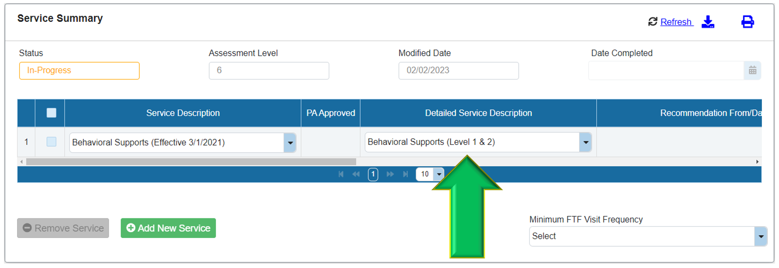
Behavioral Supports Services (BSS) – ISP Development
Behavioral Support Services (BSS) will be approved with a single service line with Level 1 & Level 2 included.

Slide 24
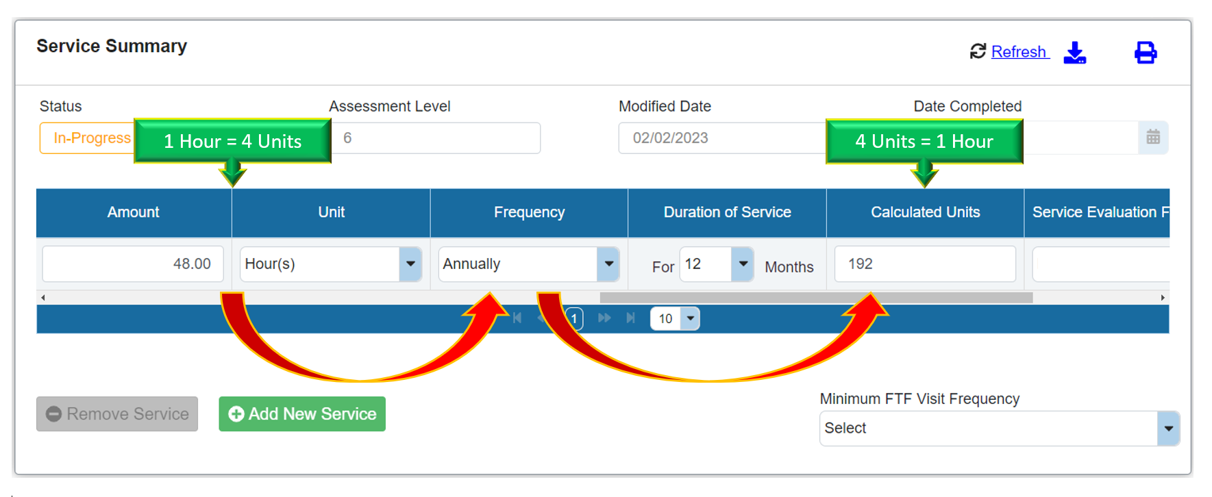
Behavioral Supports Services (BSS) – ISP Development
Behavioral Support Services (BSS) is authorized and approved with a specific number of hours (Amount) annually. The hour(s) will yield a corresponding number of units (Calculated Units).

Slide 25
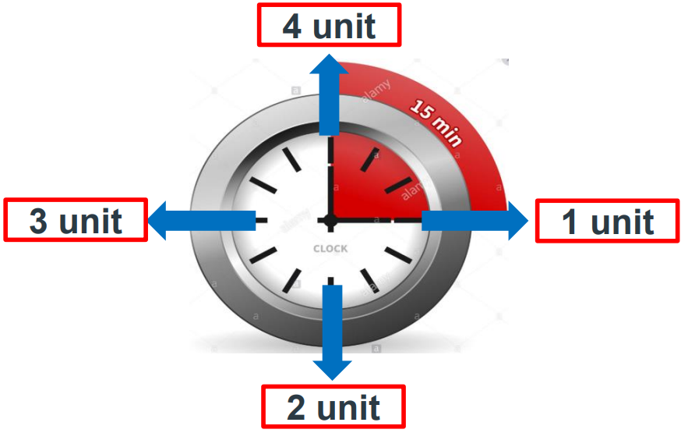
Behavioral Supports Services Level 1 & Level 2 (BSS)
BSS services are reimbursed in 15-minute unit increments using two distinct levels:
Behavioral Supports Services Level 1
Behavioral Supports Services Level 2
Center for Medicare and Medicaid Services (CMS) standard Medicaid rounding rules: Up to seven (7) minutes of completed services will be rounded down. Eight (8) minutes of completed services will be rounded up to a 15-minute unit.

Slide 26
Behavioral Supports Services (BSS) – PA Development
Behavioral Support Services (BSS) approved in the ISP will be authorized on the prior authorization (PA) with 2 distinct procedure codes and modifiers.

Slide 27
Behavioral Supports Services (BSS) – PA Development
The Behavioral Support Services (BSS) authorized amount on the PA service line is generated by the listed units and the Level 2 rate of $25.23 (the highest of the two rates for BSS).

Slide 28
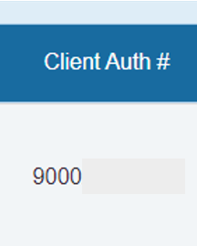
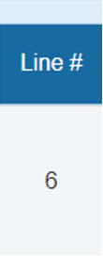
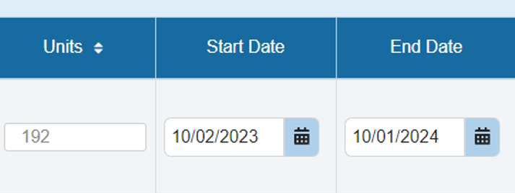
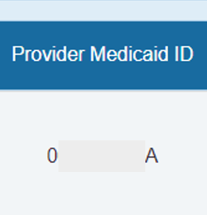
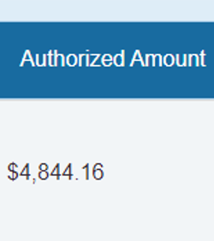
Behavioral Supports Services (BSS) – PA Development
The key sections on the PA service line that are sent to the GA Medicaid Management Information System (GAMMIS):

Slide 29
Behavioral Supports Services (BSS) – GAMMIS
Medicaid/GAMMIS State Access View (DBHDD, DCH & Gainwell)
BSS Procedure Codes and Modifiers are visible to State users (GAMMIS).

Slide 30
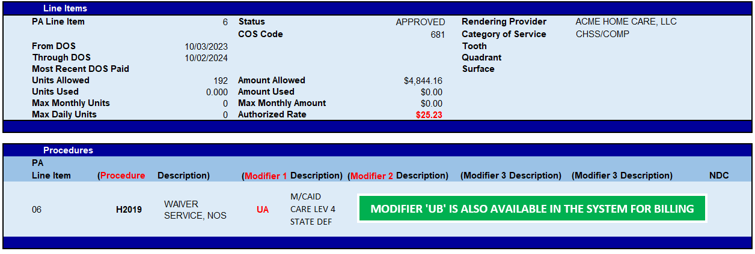
Behavioral Supports Services (BSS) – GAMMIS
Medicaid/GAMMIS Provider Access View (Web Portal)
Only H2019-UA is visible to providers but H2019-UB is also available for billing.

Slide 31
Medicaid Payment Methodology – NOW & COMP
Pay Authorized Rate (Prior Authorization) |  | Pay System Price (GAMMIS)
Payment based on elements listed the Prior Authorization such as the service/procedure code and the authorized rate (Inactive) |  | Payment based on elements of the Fee Schedule (Rate Table) such as the service/procedure code and rate within the Medicaid system (Active)

Slide 32
Behavioral Supports Services (BSS) – Medicaid Rate Table
Medicaid Rate Table (Fee Schedule)
Note: BSS reimbursement is based on fee schedule rate, not PA rate.

Slide 33
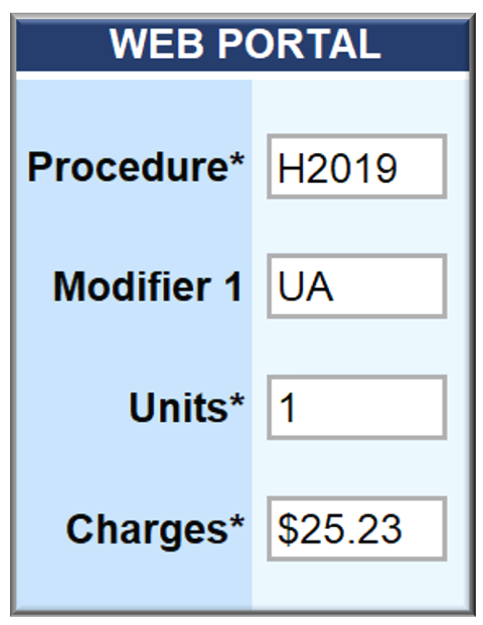
Behavioral Supports Services (BSS) – Billing Guidance
Billing Example #1 (Claim Submission)

Slide 34
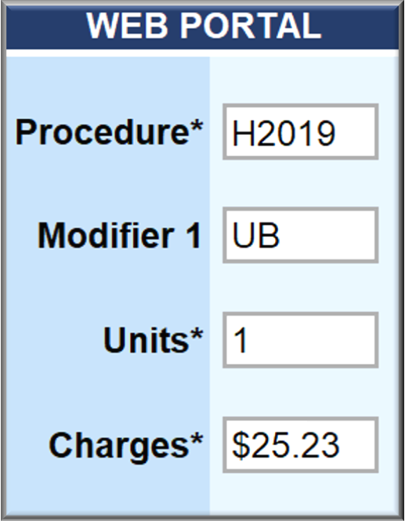
Behavioral Supports Services (BSS) – Billing Guidance
Billing Example #2 (Claim Submission)

Slide 35
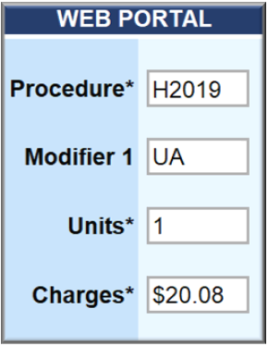
Behavioral Supports Services (BSS) – Billing Guidance
Billing Example #3 (Claim Submission)

Slide 36
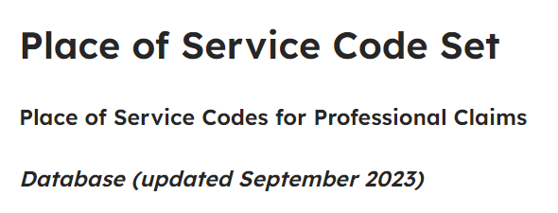
Behavioral Supports Services (BSS) – Billing Guidance
Place of Service (POS) Codes for Professional Claims
Per CMS: Place of Service “codes should be used on professional claims to specify the entity where service(s) were rendered.”
https://www.cms.gov/medicare/coding-billing/place-of-service-codes/code-sets

Slide 37
Behavioral Supports Services (BSS) – Billing Guidance
Place of Service (POS) Codes for BSS (4)

Slide 38
Behavioral Supports Services (BSS) – Billing Guidance
Place of Service (POS) Codes for BSS (4)

Slide 39
Behavioral Supports Services (BSS) – Billing Guidance
Place of Service (POS) Codes for BSS (4)

Slide 40
Behavioral Supports Services (BSS) – Billing Guidance
Place of Service (POS) Codes for BSS (4)
Note: Please review the BSS chapters in Part III of the NOW and COMP for service delivery “settings”.

Slide 41
Troubleshooting for Billing & Claims
If you experience billing difficulties with NOW and/or COMP services, please be sure to reach out to your Gainwell Representative for assistance. Information and guidance for contact information can be found at: https://www.mmis.georgia.gov
Gainwell Technologies is the fiscal agent for Georgia Medicaid and PeachCare for Kids®.

Slide 42
Thank You!
Ronald.Singleton@dbhdd.ga.gov
Contact Number: 404-293-7594

Slide 43
DBHDD Autism Services Overview
Maliha Haider-Bardill
Autism Project Manager,
Office of Crisis and Transition Services
Division of IDD

Slide 44
Today’s agenda
Brief overview of Autism Spectrum Disorder (ASD)
Strategies for working with individuals with ASD
ASD crisis support services
This Photo by Unknown Author is licensed under CC BY-SA

Slide 45
A note on language
Person-First
Identity-First
“They have autism/ASD”
Standard among professionals
Disability does not define the person
“They are autistic”
Often preferred by members of the community
See their autism as inextricable from themselves
When in doubt, ask!

Slide 46
What is ASD?
Neurological
Affects the brain
Impacts the way individuals communicate with and interpret their environment
Developmental
Throughout the lifespan

Slide 47
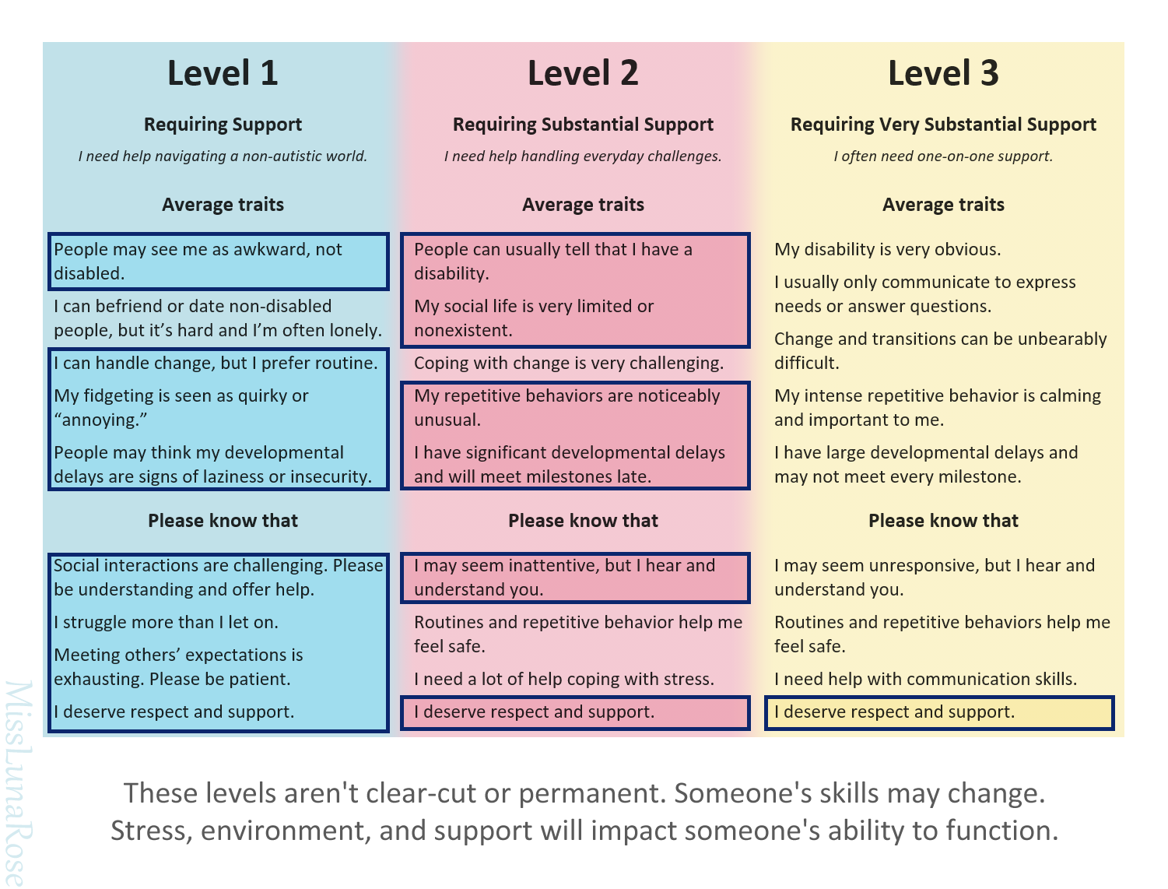
Functional levels of ASD

Slide 48
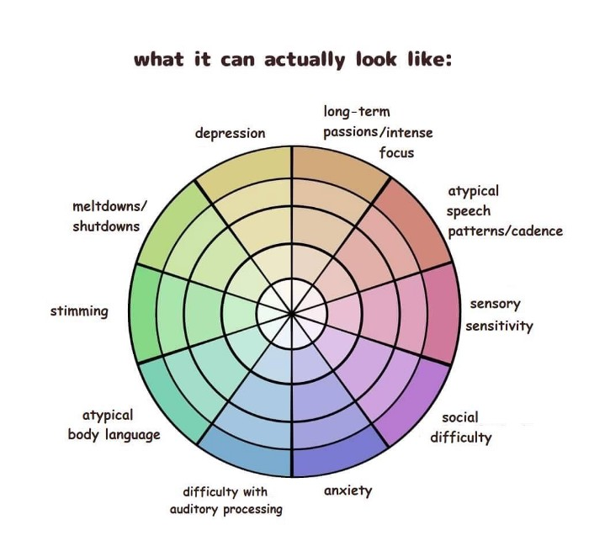
Autism is not linear

Slide 49
Strategies for Working with
Individuals with ASD

Slide 50
If you've met one person with autism, you've met one person with autism. ~ Dr. Stephen Shore, autistic professor of special education
“
”

Slide 51
Facilitating Communication
Use visual supports
Incorporate their interests to promote engagement
Gain attention first
“Paying attention” does not always mean making eye contact
Allow time to process information
Be aware of your environment; sensory differences can affect processing time/ability
Use concrete language
Utilize the communication method that works best for them

Slide 52
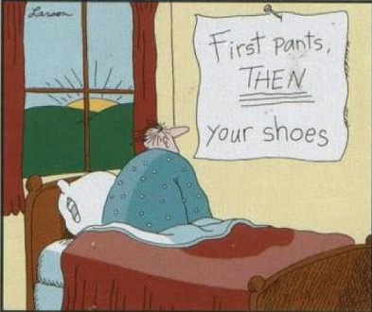
Visual Supports
Daily schedule
First-Then board
Typically used to communicate instructions or expectations
Less preferred activity followed by a more preferred activity
Can help support through transitions
Time Timer
Picture Exchange Communication System (PECS)
Physical cards or assistive technology
Choice boards
Social Stories

Slide 53
Sensory Considerations
Sensory Seeking
Sensory Avoiding
Exercise
Running, basketball
Handheld massager
Pressure
Body sock, hand squeezes
Sensory bins
Shaving cream, slime, dry rice
Chewelry
Heavy work activities
Gardening, carrying groceries
Tag-free or seamless clothing
Access to headphones or earplugs
Access to sunglasses
Slow integration of new foods
Priming before new experiences
Indirect lighting

Slide 54
Sensory Considerations
An individual may be both sensory-seeking and sensory-avoiding, depending on the specific sensory input
E.g., Craves firm pressure, but avoids bright lights
Create a safe space to regroup and aid in self-regulation
Sensory room/ calming corner
Beanbags/pillows, fidgets, punching bag, books and journaling/art materials if appropriate
How this space is designed will be unique to each person

Slide 55
Challenging behaviors: important notes
1
ASD itself does not cause challenging behaviors
All behavior is communication
We all do the best we can with the resources we have
Implementing antecedent strategies can often prevent challenging behavior. Reactive strategies are also important and should be developed by a behavior support professional
Always rule out medical first
2
3
4
5

Slide 56
DBHDD Crisis Services

Slide 57
ASD Crisis Services and Supports
Intensive in-Home
ASD Crisis Homes
ASD Crisis Stabilization Unit
Time-limited community-based behavioral intervention
Typically accessed through referral from mobile crisis
Short-term out of home behavior intervention
Typically accessed through referral from mobile crisis
10 bed CSU
Short-term out of home option for behavioral and/or medical stabilization
Typically accessed through referral from mobile crisis

Slide 58
Intensive in-Home Services
Designed to allow an individual to remain their community while receiving the supports they need
Intended to last for 7-14 days
Clinicians assess needs of individual and their support system to determine services, which could include:
Access to qualified, licensed professionals to assess needs
Implementation of existing BSP
Caregiver training
Consultation with existing services
Referrals to community-based services

Slide 59
ASD Crisis Support Homes
Currently operated by InCommunity
Homes are located in Kathleen and Jonesboro
Kathleen serves up to three youth with ASD from 10-17 years of age
Jonesboro serves up to three youth with ASD from 18-21 years of age
Team consists of Program Manager, BCBA, RN, and Case Manager
Homes staffed 24/7 with LPN and RBT/DSP
Designed to last for 30 days, or until behavioral goals are met

Slide 60
ASD Crisis Support Homes, cont.
BCBA will assess for behavioral function(s) and create behavior support plan (BSP)
Guardian(s) must be willing to participate in family training on BSP
Provides case management services to connect with local resources
Youth admitted to the Jonesboro home must be pre-eligible for waiver services
Exclusionary criteria
Cannot provide psychiatric stabilization
Cannot provide medical management or stabilization
Individual must meet Elopement Assessment criteria

Slide 61
ASD Crisis Stabilization Unit
Currently operated by View Point Health
Located in Rockdale County
Serves youth with ASD from 10-14 years of age
May have comorbid behavioral health conditions
Services include:
Crisis-related needs assessments (FBA, ADLs, medical, etc)
Therapeutic services to provide behavioral and psychiatric stabilization
Caregiver training

Slide 62
Office of Behavior Services
Dr. Beth Foster Marone
Manager of Behavior Services
Division of IDD
Georgia Department of Behavioral Health & Developmental Disabilities

Slide 63
Overview
Behavior Service Expectations
Level 2 Tasks
Chapter 1811 Telehealth Options

Slide 64
Expectations of Behavior Service Providers
Provide effective and ethical services using behavior-analytic approaches
Stay within their specific scope of practice and expertise
Seek appropriate supervision and consultation for difficult cases
Collect and analyze reliable and accurate data from all caregivers (do not rely on or graph verbal reports)
Share the outcomes of data analysis with team members (CRA, CAG, caregivers)
Reach out to DBHDD staff for support when issues with data, scheduling, training, etc. arise as soon as possible
Maintain and upload accurate notes including time in, time out, tasks completed, and modality of service (Chapter 1800 COMP)

Slide 65
Expectations of Providers Working with BSS Providers
Community Providers
Support Coordination
Remind BSS providers to sign in/out when in person
Collect and provide accurate data to BSS providers at the intervals they request
Alert BSS provider to staff needing training
Work with telehealth options when necessary
Ensure Behavior Support Plans are uploaded or available during visits
Assist BSS providers with getting data if possible
Reach out to the Regional Behavior Analysts and/or Manager of Behavior Services as soon as possible

Slide 66
Level 1 BSS Providers (Chapter 1801)
“Under the supervision and collaboration of a Level 2 Behavior Professional.”
Level 1 Tasks
Competency-based training of a behavior support plan
Behavior observation
Fidelity monitoring of plan implementation
Communication with families and staff related to plan interventions
Behavior data collection and tracking
Coordination with the supervising Level 2 Behavior Support Service provider.

Slide 67
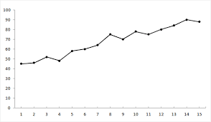
Specific Tasks Requiring Level 2 Providers
Comprehensive functional behavioral assessments
Direct (in-person) observation
Data analysis and graphing
Development of behavior support plans
Review of the effectiveness of interventions
Plan revision and termination
Level 2 practitioners may also provide tasks allowed under Level 1 description such as competency-based training of a behavior support plan to staff and/or family, fidelity monitoring of plan implementation, data collection and tracking but may delegate these tasks to a Level 1 practitioner.

Slide 68
Telehealth Options for BSS Providers
Telehealth is a supplement not a replacement for in-person BSS
“Behavior Support Service Professionals must use two-way, real-time [synchronous] interactive communication to exchange clinical/behavioral information with the individual, staff, or family from one site to another via a secure electronic communication system. Providers should have an action plan should technology fail. Telephone calls and store and forward (asynchronous) modalities are not allowed for billable behavior support services. The transmission of the individual’s behavioral or medical information from an originating site to the behavior support service provider at a distant site without the presence of the individual is not allowed for billable behavior support services.”

Slide 69
What does this mean?
The individual should be present, excluding BSP training or during reviews that may trigger behavior. Phone call “check-ins” with staff are not billable.
Emails, phone calls, transmission time, securing documents in files, etc. are not billable time.
Telehealth is a valid and reasonable option but must be used within Best Practice Standards. That means Level 2 (and Level 1 if assigned) should be conducting in-person service when necessary and needed. Using Level 1 only is not appropriate.

Slide 70
In-Person Best Practice Standards
In-person should be used whenever feasible but is required for all assessments (functional behavior assessments), initial observations, and training
Service cannot be provided solely by asynchronous methods
Level 1 AND Level 2 practitioners are expected to be geographically able to complete in-person observation, training, and assessment.
Attendance at ISP meetings is not required but is encouraged whenever feasible. If not able to attend, documentation and summaries need to be submitted with enough time for team members to respond with any questions.

Slide 71
Office of Behavior Services Behavior Analysts
Region 1 | Region 4
Caleb Ofori, BCBA Caleb.Ofori@dbhdd.ga.gov 470-895-2718 Melanie Curt-Sugar, BCBA (Part-Time) Melanie.Curtsugar@dbhdd.ga.gov 404-291-5091 | Annie Fawcett, BCBA Annie.Fawcett@dbhdd.ga.gov 229-200-3928
Region 2 | Region 5
Sherell Ellis, BCBA Sherell.Ellis@dbhdd.ga.gov 706-726-2450 | Susan Bradley, BCBA Susan.Bradley@dbhdd.ga.gov 404-831-4057
Region 3 | Region 6 (vacant)
Jessica Reeves-Beck, BCBA Jessica.Reeves2@dbhdd.ga.gov 404-623-1615 Matthew Sartin, BCBA Matthew.Sartin@dbhdd.ga.gov 470-882-0832 | Dr. Beth Foster Marone, BCBA-D Beth.Foster@dbhdd.ga.gov 404-673-0504

Slide 72
Office of Behavior Services Contacts
Michelle Ford, Ph.D., Director of Behavioral Services Michelle.Ford@dbhdd.ga.gov 404-430-2251
Beth Foster Marone, Ph.D., BCBA-D, Behavioral Services Manager Beth.Foster@dbhdd.ga.gov 404-673-0504

Slide 73
Incident Reporting for IDD Providers
Keisha Davis, PsyD, LMSW, MBA
Manager, Office of Incident Management and Compliance
Jennifer Bryant, Michelle Nix, Eshe Henderson, Andrea Jones
Supervisors, Office of Incident Management and Compliance

Slide 74
Image and Incident Reporting

Slide 75
Incident Reporting Steps
1
Refer to Policy 04-106 and Attachment A to determine if reportable
To avoid late reporting, enter incidents into Image the same business day unless a death – deaths reported within 2 hours or as soon as practicable
Respond to requests for additional information from IMA within 24 hours
Do resubmit incidents in Stage 5 after you have made corrections.
Implement any safety plan measures you’ve identified to prevent reoccurrence
As required by law or regulation, it is a provider’s responsibility to report to other parties (APS, LE, etc.)
Do add the notification in Stage 2, document in Stage 3’s incident description when you have reported to other agencies and upload any documentation confirming your report.
2
3
4
5

Slide 76
Image and Incident Reporting
All providers need to have at least one person registered in Image to report incidents in accordance with Reporting Deaths and Other Incidents in Community Services, 04-106
A backup person registered is highly encouraged to maintain compliance with reporting
To learn more about Image, you can access training resources, including the registration guide through DBHDD University
Image pulls provider contact information and location site addresses from the information listed in the provider profile with the Georgia Collaborative ASO. Therefore, consistently report any staff changes and/or location changes to the Georgia Collaborative ASO by submitting the Staff Update Form or Change of Information form as appropriate.

Slide 77
Image and Incident Reporting Continued
Additionally, be sure to set a reminder to log in to the Image Application at least once a month to keep your access active. If you forget and find yourself locked out after 45 days, please email Image.App@dbhdd.ga.gov for assistance.
When requesting reactivation of your Image account or a password reset for Image, you must use the link and/or temporary password emailed to you within 24 hours, or it expires. Please email Image.App@dbhdd.ga.gov for assistance.
When entering incident reports in Image, avoid using < or > symbols in any open text fields. These symbols cause issues in the system and will be automatically removed which may change the intent of what you have written.

Slide 78
Common Issues
Redaction / use of system generated aliases
Safety Plans/ Mitigating Steps
Incident Not Reportable
Entering Incidents in Image
Death Incident Types

Slide 79
Definition of a Reportable Incident
Any event that involves an immediate threat to the care, health or safety of any individual in community residential services, in community crisis home services, while on site or in the care of a provider, in the company of a provider staff or contractor, or enrolled in participant-directed services.
***DEATHS HAVE ADDITIONAL REPORTING PARAMETERS

Slide 80
Incident Descriptions
Please provide a brief description of the Incident to include the circumstances immediately prior to the incident, describe the incident (who, what, when, where, how), and the result.
Do not use the names or initials of any individuals or their family members-use aliases*.
Use the system generated aliases for individuals and family members (e.g., Person 1, Person 2).
It is okay for staff names to be used in the incident description. It is best not to use the system generated person identifiers for staff.

Slide 81
Common Incident Errors
Hospitalization – Medical
Admitted?
Residential?
On site/with staff?
Elopement
Out of sight?
Residential?
On site/with staff?
Medication Error
Adverse consequences?
Requires an Injury Severity of 3+
Fall, Accidental Injury
Aggressive Physical act Ind/Ind /Ind/Non-Ind
Suicide Attempt
..
ANE by non-staff
Report to APS
Report to Law Enforcement
Psychiatric Hospitalization
Involuntary
Residential?
ACT/CST/ICM?
Admitted?
Notes:
•Injury rating of 3+ is beyond first aid or hospitalization
•re: Psychiatric Hospitalization, involuntary admission is a requirement

Slide 82
Death incident types
Expected Death
Unexpected Death
Suicide
Cause of Death (COD) from terminal disease greater than 30 days
In residential services (not Shelter Plus, HUD, etc.)
Occurred on site of provider or in presence of staff
Person was discharged within 30 days of death
Doesn’t meet definition of other death codes
In residential services (not Shelter Plus, HUD, etc.)
Occurred on site of provider or in presence of staff
Person was discharged within 30 days of death
Self-inflicted death of an individual
Individual was enrolled in DBHDD services
OR
Discharged/transferred from services within 30 days of death
COD confirmed by a coroner/medical examiner

Slide 83
Death incident types
Enrolled Individual
Alleged Homicide
Don’t meet definition of other death codes
Individual was enrolled in DBHDD services
Discharged/transferred from services within 30 days of death
Injury inflicted on an individual resulting in death
Individual was enrolled in DBHDD services
Discharged/transferred from services within 30 days of death
COD confirmed by a coroner/medical examiner

Slide 84
Incident Associations
Please visit DBHDD University to access the Incident Management Image Training at:
https://dbhdduniversity.com/incident-management.html
This training also includes printable job aids for each stage of Image.

Slide 85
Email Contacts
Image Issues:
Image.App@dbhdd.ga.gov
Incident Reporting:
dbhddincidents@dbhdd.ga.gov
Investigations:
dbhdd.investigations@dbhdd.ga.gov
CAPS:
CAP.Request@dbhdd.ga.gov
Keisha Davis:
Keisha.Davis@dbhdd.ga.gov

Slide 86
Regional Break Outs
Regional “Break Out” Sessions will be led by your local RSA followed by general Q/A. Look for the table with your designated regional field office

Slide 87
General Session Q/A

Slide 88
Georgia Department of Behavioral Health & Developmental Disabilities
Notes:
USE AS END SLIDE if needed

