Slide 1
Behavioral Health Coordinating Council Meeting
Georgia Department of Behavioral Health & Developmental Disabilities
May 11, 2022

Slide 2
Agenda
Roll Call / Call to Order
Recovery Speaker
Action Items
BHCC Initiatives
IDT Update
Chair’s Report
9-8-8
General Assembly Wrap-up
BHCC Moving Forward
Next Meeting Date

Slide 3
Roll Call David Sofferin Director, Public Affairs

Slide 4
Call to Order Judy Fitzgerald Commissioner

Slide 5
Recovery Speaker Thandiwe Harris, CPS-P Program Manager DBHDD Office of Children, Young Adults & Families

Slide 6
Action Items:
February 9, 2022, Meeting Minutes
2021 BHCC Annual Report

Slide 7
BHCC Initiatives

Slide 8
Interagency Director’s Team
Renee Johnson, MPA
System of Care Director
Center of Excellence for Children’s Behavioral Health
May 11th, 2022
Georgia Department of Behavioral Health & Developmental Disabilities

Slide 9
Overview
SOC State Plan & HB 1013
IDT/SOC Rebranding
IDT Executive Committee

Slide 10
SOC State Plan
Phase 1: Prevention and Early Screening
Phase 2: Early Intervention
Phase 3: Intervention
Phase 4: Late Intervention
Phase 5: Spanning the Continuum of Care

Slide 11
HB 1013 – Mental Health Parity Act (MHPA)
Part I: Georgia Mental Health Parity Act
Part II: Workforce and System Development
Part III: Involuntary Commitment
Part IV: Mental Health Courts and Corrections
Part V: Child and Adolescent Behavioral Health
Part VI: Behavioral Health Reform and Innovation Commission

Slide 12
MHPA & SOC State Plan

Slide 13
MHPA & IDT Workgroups

Slide 14
IDT/SOC Rebranding
Darwin (www.madebydarwin.com)
Project Goals
To sharpen our focus
Examine the effectiveness of our current work
Explore insights and opportunities for our future
Project Phases
Key stakeholder interviews
Survey of current stakeholders
Immersion & Insights Workshops
Recommendations developed for BHCC review and approval

Slide 15
Early Observations
A need for clarity around IDT and SOC work.
To be seen and heard as subject matter experts for behavioral health.
More support and promotion of IDT initiatives and activities.
Be invited to the table when important discussions are taking place.

Slide 16
IDT Executive Committee
Current Committee Members
Erica Fener Sitkoff, Executive Director – Voices for Georgia’s Children ​
LaMarva Ivory, Deputy Commissioner, External Affairs – DHS
VACANT - DCH​
Dahlia Bell-Brown, Program Officer - Woodruff Foundation ​
Margaret Caywood, Deputy Commissioner, Division of Support Services - DJJ ​
Matt Jones, Chief of Staff, Georgia DOE ​
Monica Johnson, Director, Division of Behavioral Health - DBHDD ​
Susan Adams, Deputy Commissioner, Georgia DECAL

Slide 17
Chair’s Report: Judy Fitzgerald Commissioner

Slide 18
General Assembly
Wrap-up
Georgia Department of Behavioral Health & Developmental Disabilities
Michael Polacek
Director, Legislative Affairs

Slide 19
2022 DBHDD Legislative Update
The “Year of Mental Health” in Georgia
100+ behavioral health bills introduced during the 2021-2022 legislative sessions
Major themes – Workforce, Parity, and Public Safety
Historic year for DBHDD budget

Slide 20
Behavioral Health Legislative Overview
HB 1013 - Mental Health Parity Act (Mental Health Omnibus Bill)
SB 403 - Georgia Behavioral Health and Peace Officer Co-Responder Act
SB 610 - instructs DCH to submit a waiver request to CMS allowing private mental health institutions to be Medicaid reimbursable
SB 500 - A litigation bar on governmental entities regarding certain statewide opioid litigation; provide
HB 752 - Psychiatric Advance Directive Act
SR 659 - Senate Study Committee on Unsheltered Homelessness; create

Slide 21
HB 1013 – “Mental Health Parity Act”
Overview
Hospital and Short-Term Care Facilities
Workforce and System Development
Involuntary Commitment
Mental Health Courts and Corrections
Child and Adolescent Behavioral Health

Slide 22
Beginning 9-8-8 Rollout in Georgia
Dawn Peel
Director, Office of Crisis Coordination
Wendy White Tiegreen
Director, Office of Medicaid Coordination & Health System Innovation
Behavioral Health Coordinating Council
May 11, 2022
Notes:
Speaker: Dawn

Slide 23
9-8-8 is a direct, national three-digit dialing code that will connect individuals with suicide prevention and behavioral health crisis resources.
Starting July 16, 2022, anyone will be able to call 9-8-8.
Callers will be connected to a trained staff member who can help address immediate needs and connect the callers to care resources, 24 hours a day, 7 days a week, 365 days a year.
Notes:
Speaker: Dawn
A direct, national three-digit line, 9-8-8, will open the door for millions of Americans to seek the help they need, while sending the message to the country that healing, hope and help are happening every day. In Georgia, the 9-8-8 calls will be answered by the Georgia Crisis and Access Line (GCAL), 24 hours a day, 7 days a week, 365 days a year.
Some of 9-8-8’s key features include:
Connecting a person in a behavioral health crisis to someone who can address their immediate needs and help connect them to ongoing care
Promote cost efficiency by providing the most appropriate response
Reducing burden on law enforcement, public health and other safety resources when not appropriate
Helping end stigma of seeking or accessing behavioral healthcare

Slide 24
Some of 9-8-8’s key features include:
Connect a person with immediate and ongoing resources
Promote cost efficiency
Reduce impact on law enforcement and safety resources
Help end stigma of seeking care
9-8-8 is an opportunity:
One of the largest federally mandated crisis response transformations in decades.
Designed to meet the rising needs
of mental health, substance abuse disorders and suicide interventions.
Notes:
Speaker: Dawn
A direct, national three-digit line, 9-8-8, will open the door for millions of Americans to seek the help they need, while sending the message to the country that healing, hope and help are happening every day. In Georgia, the 9-8-8 calls will be answered by the Georgia Crisis and Access Line (GCAL), 24 hours a day, 7 days a week, 365 days a year.
Some of 9-8-8’s key features include:
Connecting a person in a behavioral health crisis to someone who can address their immediate needs and help connect them to ongoing care
Promote cost efficiency by providing the most appropriate response
Reducing burden on law enforcement, public health and other safety resources when not appropriate
Helping end stigma of seeking or accessing behavioral healthcare

Slide 25
9-8-8 Suicide & Crisis Lifeline Overview
The 9-8-8 law requires Georgia to enhance the current system’s ability
to respond to those experiencing a behavioral health crisis by providing:
Someone to talk to
Someone to respond
A Safe Place to Go
Available 24/7 for calls, text and chat
Peer-run warm lines offering callers emotional support, staffed by individuals who are in recovery themselves
Mobile crisis available statewide
Coordinate with 9-1-1/EMS as appropriate
Outpatient community provider response
Crisis stabilization units
Crisis service center
Peer wellness respite
Detox and Substance Use Disorder (SUD) treatment
Inpatient beds
Outpatient crisis
Notes:
Speaker: Dawn
When there is a mental health or substance use emergency, many do not know what to do. Call their primary care doctor? Call the police? Call 9-1-1? Go to the emergency room? These responses impact local law enforcement and emergency services and rarely provide the most effective result for the individual experiencing the behavioral health crisis.
In Georgia you can call/text or chat GCAL now, but starting on July 16, 2022, individuals will be able to dial 9-8-8 for suicide prevention and behavioral health crisis resources. Individuals will still be able to access outpatient treatment or seek assistance from Behavioral Health Crisis Centers as well.
9-8-8 provides an easy-to-remember three-digit number to provide access to immediate behavioral health support.
OUTPATIENT TREATMENT IS STILL THE BEST WAY TO ACCESS TREATMENT PRIOR TO A CRISIS. ENCOURGING OTHERS TO SEEK TREATMENT BEFORE A CRISIS ARISES IS CRUCIAL.

Slide 26
Someone to Call: Georgia Behavioral Health Crisis Call System
Current and Future
Georgia Crisis & Access Line
Calls and Texts
1-800-715-4225 (GCAL)
Current and Future National Suicide Prevention Lifeline Calls
1-800-273-8255
NEW 9-8-8
Calls
9-8-8
Crisis Line Calls not answered
in Georgia within 3 minutes
are rerouted nationally
Current and Future
9-1-1 Behavioral Health Calls
9-1-1
Expanded and Enhanced
Georgia Crisis Call Center
or
National Crisis Call Centers
Local interventions, including law enforcement co-responder teams, where available
Notes:
Speaker: Dawn
When there is a mental health or substance use emergency, many do not know what to do. Call their primary care doctor? Call the police? Call 9-1-1? Go to the emergency room? These responses place an unnecessary burden on local law enforcement and emergency services and rarely provide the most effective result for the individual experiencing the behavioral health crisis.
In Georgia you can call/text or chat GCAL now, but starting on July 16, 2022, individuals will be able to dial 9-8-8 for suicide prevention and behavioral health crisis resources. GCAL, the current Lifeline number, and 988 will all be available after July 16, 2022 as a "No Wrong Door" approach to seeking assistance.
9-8-8 provides an easy-to-remember three-digit number to provide access to immediate behavioral health support.

Slide 27
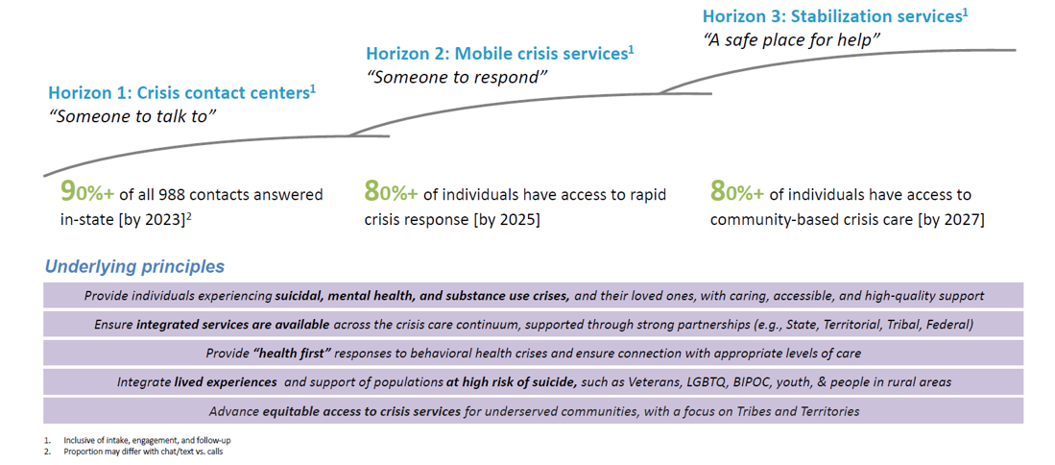
SAMHSA – Five-year vision for 9-8-8
Notes:
Speaker: Dawn
Mention the 911 Rollout. We are taking lessons learned from the 911 rollout to improve staffing, technology, and other efficiencies.
Started in 1969, it took 30 years to achieve coverage of 93% of the country. SAMHSA has identified a five year vision to expand the crisis system to accommodate the anticipated expanded volume of people seeking help.
We will take lessons learned from 9-1-1 implementation:
build capacity and staffing over time
focus on technology and infrastructure
SAMHSA's messaging is that these statistics is a minimum goal but the hope is to reach higher percentages than are noted on this slide.

Slide 28
Georgia’s Response
9-8-8 planning efforts and implementation activities are led by DBHDD with input from additional stakeholders:
DBHDD Steering Committee
9-8-8 Planning Coalition
In Georgia, the Department of Behavioral Health and Developmental Disabilities (DBHDD) is the state behavioral health authority as designated in O.C.G.A. § 37-1-20 and, as such, is the lead agency for the 9-8-8 implementation.
Coalition Representation
9-1-1 Behavioral Health Link (BHL) Benchmark Children’s Healthcare of Atlanta CSU and BHCC providers DBHDD Suicide Prevention Georgia Collaborative ASO Grady Memorial Hospital Sheriffs | American Foundation for Suicide Prevention Georgia (AFSP) Community Service Boards (CSBs) Georgia Council on Substance Abuse (GCSA) Department of Public Health EMS Georgia Crisis and Access Line (GCAL) Veteran’s Administration | Georgia Emergency Communication Authority (GECA) Georgia Mental Health Consumer Network (GMHCN) Georgia Parent Support Network (GPSN) Governor’s Office of Planning and Budget Mental Health America of Georgia National Alliance on Mental Illness Georgia (NAMI) Police Departments
Notes:
Speaker: Dawn
In April 2021, DBHDD identified stakeholders across the crisis continuum, such as behavioral health providers, 9-1-1, law enforcement and lived experience advocates, to serve as members for the Georgia 9-8-8 Planning Coalition. Members were identified based on the categories of key 9-8-8 stakeholders provided by Vibrant, and will provide subject-matter expertise critical to Georgia’s current crisis system and planning for the future system.
The Georgia 9-8-8 Planning Coalition met monthly, two-hour virtual sessions from April 2021 through February 2022. During these sessions, coalition members discussed on the current state, challenges, and opportunities for enhancements across their respective components of the crisis continuum (e.g., current Lifeline call center, 911 centers, mobile crisis teams, crisis stabilization, and peer services). In addition, the Coalition utilized Mural, a web-based collaboration tool, to solicit input from members on key gaps and planning considerations for 9-8-8. The focus on the Coalition has shifted to identifying special needs of populations considered to be at high risk for suicide (I.e. veterans, young people). Meetings with representatives from these groups will identify how to ensure the Georgia 988 plan is inclusive and reflects the needs of these groups.
DBHDD has also activated workgroups focused on various elements across communications, public private partnerships, legislation, capacity building and call center capabilities to support and inform 9-8-8 planning. These workgroups have been meeting regularly to discuss and plan for the eight planning considerations put forward by the grant and design the future state crisis system.

Slide 29
Georgia’s Response
In our ongoing coalition meetings,
key themes have emerged as either gaps in our current crisis system or important considerations when planning for 9-8-8:
275,000
total calls, texts and chats to the Georgia Crisis and Access Line (GCAL) in FY21 –
highest volume since inception
Workforce shortages
Need for better coordination among stakeholders
Standardized policies, processes and protocols
Training on services/protocols/ recovery-focused language
Public awareness about crisis services and success stories
+24% increase
Notes:
Speaker: Dawn
The key themes listed here were identified from the Coalition meetings.
1. Workforce shortages – identified the need to create short and long-term solutions for behavioral health workforce challenges. These challenges have been heightened by the increased volume of calls to GCAL during the past fiscal year.
2/3. Improving coordination among partners is an area that is key to the success of 988 in Georgia. Much work has been done to ensure the behavioral health, emergency healthcare, first responders, and 911 centers are working together to identify efficiencies and improve processes. One example of this work is 988/911 Policy Academy work that has recently begun. Georgia was one of five states invited to work with SAMHSA's GAIN Center to examine processes and protocols for 911/ 988 collaboration. This important work will help to standardize policies/ procedures/ protocols.
4. Training is being planned for law enforcement and other first responders to provide them a clear understanding of 988 and how it's rollout might impact their work. The DBHDD Steering team is also working to create training modules not only for community partners but also for different parts of our crisis system to ensure members understand how to maximize the impact of the crisis system. Training related to recovery-focused language has been underway with members of our crisis network.
5. Public awareness of crisis services – will be addressed in a future slide when we discuss our rollout messaging.

Slide 30
Georgia’s Crisis System: Current and Future State
FUTURE STATE
Note: Numbers reflect FY23 volume (federal projections)
CURRENT STATE
Note: Numbers reflect FY21 volume
Someone to Talk to
564,608
calls
Someone to Talk to
texts and chats received
275,000 calls texts and chats received
(24% increase from previous year)
Call volumes increase by 105%
over 2x the current volume
over 2x the current volume
Notes:
Speaker: Dawn
Add percentage increase for call volume
Dawn: The call volume in FY21 increased 24% from the prior year for a total of 275,000 calls. This corresponds to an average of 700 calls per day to GCAL. Projections from Vibrant suggest Georgia could receive 564,000 total calls in FY23.

Slide 31
Georgia’s Crisis System: Current and Future State
FUTURE STATE
Note: Numbers reflect FY23 volume (federal projections)
CURRENT STATE
Note: Numbers reflect FY21 volume
Someone to Respond
56,460
Mobile Crisis
Responses
Someone to Respond
20,395
Mobile Crisis
Responses
Mobile Crisis Responses increase by 176%
Notes:
Speaker: Dawn
Add percentage increase for call volume
FY21 mobile crisis dispatches totaled 20,395. Federal projections estimate 56,460 calls in FY23 which is an increase of 163%.

Slide 32
Georgia’s Crisis System: Current and Future State
FUTURE STATE
Note: Numbers reflect FY23 volume (federal projections)
CURRENT STATE
Note: Numbers reflect FY21 volume
Somewhere to Go
67,137 admissions to community crisis beds
Somewhere to Go
32,700 admissions to community crisis beds
Bed Capacity will need to increase by 105%
Notes:
Add percentage increase for call volume

Slide 33
Current Expenditures
$14 million
call center
$235M
annual expenditures
$193 million
Crisis beds
$28 million
mobile crisis teams
GCAL and Mobile Crisis Response are currently financed through state and federal funding
and the community crisis beds are funded by the state
Notes:
Speaker: Wendy
The Subacute residential services are subject to the IMD rule and currently most don’t bill for services. For the few that are small enough to bill we don’t have the ability to see that billing.
GCAL/ MCTs financed through state and federal funding – federal funding is block grant funds. MCT also uses Medicaid Administrative funds. BHCC/ CSU/ SCBs are funded through state appropriations.
GCAL (part of the administrative contract with Beacon)
Total: $9,195,884
Federal: $2,744,971
State: $6,450,913
BHCC’s
Total: $119,825,523 (all State)
CSU’s (that are not part of a larger BHCC, includes both Adult and C&A beds)
Total: $51,173,469 (all State)
State Contracted Beds
Total: $21,623,125 (all State)
Mobile Crisis (includes both IDD and BH)
Total: $21,810,310
Federal: $14,201,413
State: $7,608,897

Slide 34
Actions: Rollout of 9-8-8 in Georgia
Increasing Capacity and Agility
On a Short Runway
Completed
Implemented telehealth solutions in jails, hospitals, and schools to expand the capacity of licensed clinical staff on mobile crisis response teams
Enhanced call routing to prioritize clinicians for most urgent calls
Underway
Updating Crisis Call Center dashboard or "bed board" infrastructure to improve care coordination
Expanding call center and mobile crisis response team staffing
Considering telehealth options for community-based mobile crisis response
Notes:
Speaker: Wendy
Increased Capacity and Agility:
Completed – mobile crisis teams were able to begin using telehealth during the pandemic to meet the needs of individuals when staff could not be onsite. DBHDD is consulting with mobile crisis providers about how to further increase the capacity of existing licensed clinicians to expand telehealth services after the 988 rollout begins.
Underway – updating GCAL dashboard will not only improve care coordination for individuals in need of crisis services but will also improve efficiency of the GCAL system to maximize existing staff.
Expansion of call center staffing - 25 additional staff approved including direct call center staff, trainers, reporting staff, and community liaisons
RE: GPS - DBHDD has 2 providers of mobile crisis services. One has proprietary software for GPS enabled dispatch. This will pay the monthly fee for the software for Benchmark Human Services through their current RFP. The added technology will allow for better data collection and allow Georgia to better forecast needs in mobile crisis as 988 is implemented. It will also allow enhanced ability to track outcomes.
RE: 7 MCT staff - Benchmark tracks and dispatches by phone calls currently. With the added technology for GPS dispatch, they will need staff in each of their covered regions to ensure proper dispatches occur. The positions will monitor the dispatch app and make sure staff are completing the task needed to show arrival and completion of calls. This will fund 7 FTE positions to cover 2 regions 24/7/365. 2 positions for 2 shifts a day and one position overnight.

Slide 35
Increasing Funding: Rollout of 9-8-8 in Georgia
STATE FUNDING
FY 22 Budget
Planning ($114K)
IT Upgrades ($302K)
FY 23 Budget
Conversion of an existing Crisis Stabilization Unit (CSU) into a Behavioral Health Crisis Center (BHCC) in Augusta ($3.8M)
17 additional BHCC beds in Columbus ($3.1M)
Additional Call Center staff ($1.5M)
Grady psychiatric crisis beds ($6M)
FEDERAL FUNDING
ARPA federal funds: ($2M)
GPS for Mobile Crisis FY 24
+ 25 Call Center staff
+ 7 Mobile Crisis Response Dispatchers FY 22
Call Center dashboard enhancements ($639K)
SAMHSA Grant
$3M just awarded
Notes:
Speaker: Wendy
Increased Capacity and Agility:
Completed – mobile crisis teams were able to begin using telehealth during the pandemic to meet the needs of individuals when staff could not be onsite. DBHDD is consulting with mobile crisis providers about how to further increase the capacity of existing licensed clinicians to expand telehealth services after the 988 rollout begins.
Underway – updating GCAL dashboard will not only improve care coordination for individuals in need of crisis services but will also improve efficiency of the GCAL system to maximize existing staff.
Expansion of call center staffing - 25 additional staff approved including direct call center staff, trainers, reporting staff, and community liaisons
RE: GPS - DBHDD has 2 providers of mobile crisis services. One has proprietary software for GPS enabled dispatch. This will pay the monthly fee for the software for Benchmark Human Services through their current RFP. The added technology will allow for better data collection and allow Georgia to better forecast needs in mobile crisis as 988 is implemented. It will also allow enhanced ability to track outcomes.
RE: 7 MCT staff - Benchmark tracks and dispatches by phone calls currently. With the added technology for GPS dispatch, they will need staff in each of their covered regions to ensure proper dispatches occur. The positions will monitor the dispatch app and make sure staff are completing the task needed to show arrival and completion of calls. This will fund 7 FTE positions to cover 2 regions 24/7/365. 2 positions for 2 shifts a day and one position overnight.

Slide 36
Increasing Funding: Upstream Crisis Prevention
STATE CRISIS PREVENTION FUNDING
New state funding (i.e. prevention, youth, and core capacity)
Mental Health and Addiction Core Outpatient Services (FY 22+FY23) = $17.1M
Apex (FY22+FY23) = $7.6M
Suicide Prevention (FY 22) = $290K
Development of two demonstration sites for
Certified Community Behavioral Health Centers
(FY 23) = $4M
Notes:
Speaker: Wendy
Increased Capacity and Agility:
Completed – mobile crisis teams were able to begin using telehealth during the pandemic to meet the needs of individuals when staff could not be onsite. DBHDD is consulting with mobile crisis providers about how to further increase the capacity of existing licensed clinicians to expand telehealth services after the 988 rollout begins.
Underway – updating GCAL dashboard will not only improve care coordination for individuals in need of crisis services but will also improve efficiency of the GCAL system to maximize existing staff.
Expansion of call center staffing - 25 additional staff approved including direct call center staff, trainers, reporting staff, and community liaisons
RE: GPS - DBHDD has 2 providers of mobile crisis services. One has proprietary software for GPS enabled dispatch. This will pay the monthly fee for the software for Benchmark Human Services through their current RFP. The added technology will allow for better data collection and allow Georgia to better forecast needs in mobile crisis as 988 is implemented. It will also allow enhanced ability to track outcomes.
RE: 7 MCT staff - Benchmark tracks and dispatches by phone calls currently. With the added technology for GPS dispatch, they will need staff in each of their covered regions to ensure proper dispatches occur. The positions will monitor the dispatch app and make sure staff are completing the task needed to show arrival and completion of calls. This will fund 7 FTE positions to cover 2 regions 24/7/365. 2 positions for 2 shifts a day and one position overnight.

Slide 37
Next Steps: Rollout of 9-8-8 in Georgia
Projecting Demand
and Capacity Needs
Ongoing analysis of future capacity and funding priorities for multi-year ramp up
Additional federal standards expected to be released, such as: staffing patterns, performance metrics, and call response times
Federal 9-8-8 Playbook released on April 20 and others are in development
Federally driven marketing strategy appears to be pushing to July 2023
Implementing short- and long-term strategies to mitigate workforce challenges
Exploring Future Funding Opportunities
Federal funding
Explore mechanisms to draw down additional Medicaid dollars
State funding
Capital Bonds
Telecommunication fee
Notes:
Projecting Demand and Capacity Needs:
Ongoing analysis of future capacity over multi-year ramp up. Our plans for multi-year ramp up plan is in line with a recent announcement by our federal partners.
Federal guidelines – marketing strategy recommendations include educating populations who current use our behavioral health crisis system, partners (law enforcement, first responders), and high risk populations in the near term but pushing large scale marketing of 988 until July 2023.
Future Funding opportunities:
Federal funding through block grant and other grant opportunities
Medicaid funding – Administrative funds versus 85/15
Telecommunication fee - The federal legislation not only put 988 into law, but it also allows states to implement monthly fees on telecommunications bills. While other states have rushed to pass fees, Georgia leaders will continue to assess actual call volume to determine how best to approach funding this long-term transformation of Georgia’s crisis infrastructure.

Slide 38
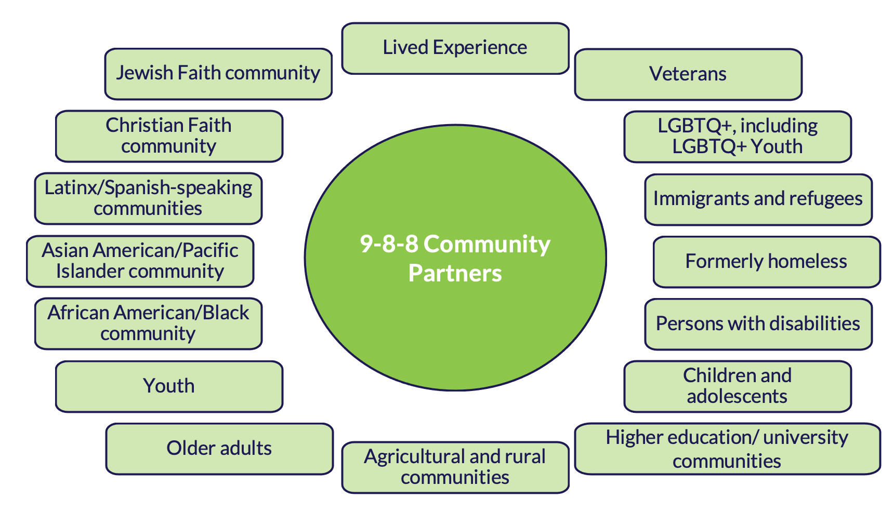
Next Steps: Two-Way Communications
Input, Engagement and Two-Way Communications About the Rollout
Will NOT be marketing widely until mid-2023, per SAMHSA guidance. Focusing in interim on stakeholder education and awareness among traditionally at-risk populations (veterans, young people, LGBTQ+)
Just launched information site 988ga.org with evolving FAQs, and fact sheets, including ways for all stakeholders in Georgia to ask specific questions.
Multiple interagency and community stakeholder working groups.
Have conducted numerous listening sessions and input workshops for various stakeholder groups.
Continuing to emphasize the importance of early treatment/interventions and NOT waiting for a crisis
Notes:
Projecting Demand and Capacity Needs:
Ongoing analysis of future capacity over multi-year ramp up. Our plans for multi-year ramp up plan is in line with a recent announcement by our federal partners.
Federal guidelines – marketing strategy recommendations include educating populations who current use our behavioral health crisis system, partners (law enforcement, first responders), and high risk populations in the near term but pushing large scale marketing of 988 until July 2023.
Future Funding opportunities:
Federal funding through block grant and other grant opportunities
Medicaid funding – Administrative funds versus 85/15
Telecommunication fee - The federal legislation not only put 988 into law, but it also allows states to implement monthly fees on telecommunications bills. While other states have rushed to pass fees, Georgia leaders will continue to assess actual call volume to determine how best to approach funding this long-term transformation of Georgia’s crisis infrastructure.

Slide 39
Right now, in Georgia, anyone experiencing a suicidal crisis or emotional distress should
call GCAL at 1-800-715-4225 or download the My GCAL app,
available on both iOS and Android devices, to access GCAL via text and chat.
GCAL is available 24 hours a day,
7 days a week.
For more information about Georgia's 9-8-8 Rollout please visit www.988ga.org
Notes:
Speaker: Wendy
A direct, national three-digit line, 9-8-8, will open the door for millions of Americans to seek the help they need, while sending the message to the country that healing, hope and help are happening every day. In Georgia, the 9-8-8 calls will be answered by the Georgia Crisis and Access Line (GCAL), 24 hours a day, 7 days a week, 365 days a year.
Some of 9-8-8’s key features include:
Connecting a person in a behavioral health crisis to someone who can address their immediate needs and help connect them to ongoing care
Promote cost efficiency by providing the most appropriate response
Reducing burden on law enforcement, public health and other safety resources when not appropriate
Helping end stigma of seeking or accessing behavioral healthcare

Slide 40
BHCC Moving Foward

Slide 41
Questions

Slide 42
Next BHCC Meeting August 10, 2022

Slide 43
Georgia Department of Behavioral Health & Developmental Disabilities

