Slide 1
Board of Behavioral Health and Developmental Disabilities
Georgia Department of Behavioral Health & Developmental Disabilities
June 14, 2018

Slide 2
Agenda
Call to Order
Recovery Speaker
Action Items Minutes Bond Resolution
Commissioner’s Report
Chair’s Report
Public Comment
Next Meeting Date

Slide 3
Call to Order Kim Ryan Chair

Slide 4
Recovery Speaker Silvia Beam

Slide 5
Action Items: - Approval of Minutes - Bond Resolution-General Obligation Bond Sale

Slide 6
Commissioner’s Report Judy Fitzgerald Commissioner

Slide 7
DBHDD Crisis Services: The Growth of an Innovative System Debbie Atkins, LPC Director, Crisis Coordination

Slide 8
Vulnerability is the birthplace of innovation, creativity, and change. - Brené Brown
“
”

Slide 9
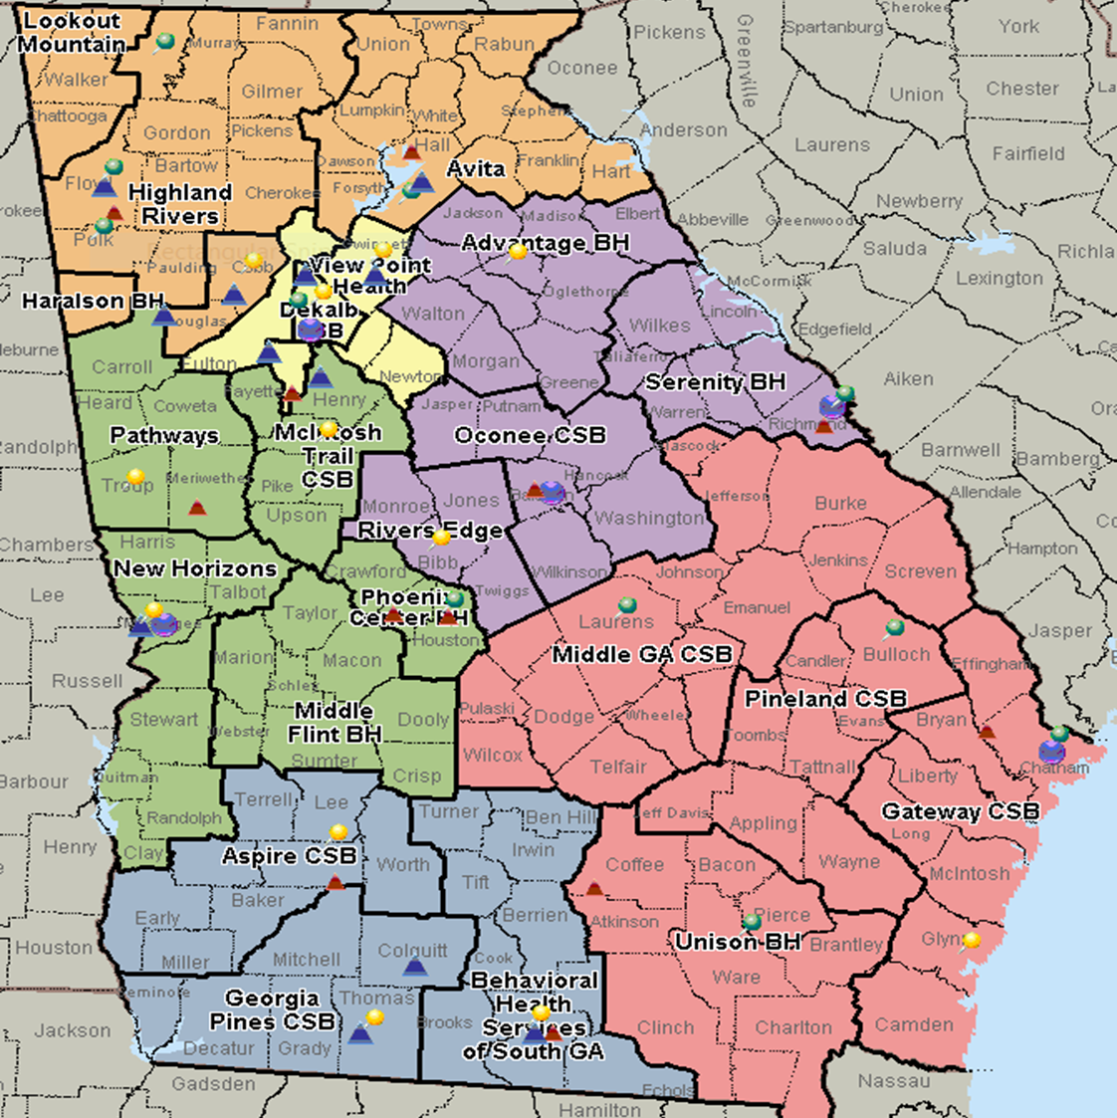
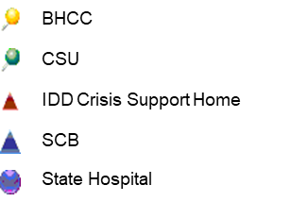
FY 2009 FY 2018
Head Trauma Protocol
Tuberculin Skin Testing (TST) Procedure
Emergency Cart
Glucometer Training

Slide 10
Comparison of Individuals Served
Adult mental health bed capacity at state hospital has been reduced in order to fund resources in the community, which creates better continuity of care and better access to services where individuals live
Mobile crisis has created diversion from inpatient settings, and referrals to services in the community
CSUs have increased their capacity to treat individuals closer to home
In areas where there is a need, contract beds have been added to meet demand
Behavioral Health Crisis Admissions | FY 2009 | FY 2017
Mobile Crisis | N/A | 14,342
Crisis Stabilization | 14,959 | 24,228
State Contract Beds | N/A | 6,644
State Hospital (AMH) | 9,557 | 2,622
Total | 24,516 | 47,836

Slide 11
Comparison of Individuals Served and Bed Capacity
State hospitals are able to focus on individuals who need longer, more specialized care
More individuals are being served closer to home
With the addition of the temporary observation, a person is able to have intensive services in a 23-hour timeframe to stabilize the current crisis and allow the individual to return to the community for ongoing services
Type of Bed | FY 2009 | FY 2017
State Hospital | 640 | 280
Crisis Stabilization | 359 | 509
Temporary Observation | N/A | 96
Total | 999 | 885

Slide 12
Advancements to the System
Moving to a Behavioral Health Crisis Service Center (BHCC) Model
Crisis Service Center (Urgent Care)
Temporary Observation (Emergency Services)
Crisis Stabilization (Inpatient Stabilization)

Slide 13
Advancements to the System
Technology Enhancements
Statewide referral board
Ability to forecast supply and demand
Ability to measure key performance indicators (KPI) for the system
Blending mobile crisis services for both the behavioral health and intellectual and developmental disability systems

Slide 14
New Referral Board will go live July 1, 2018

Slide 15
Office of Human Resources and Learning Theodore Carter, Jr., Senior Director of Learning April Umstead, Ph.D., Training Program Director

Slide 16
The organizations that will truly excel in the future will be those that discover how to tap people’s commitment and capacity to learn at all levels of the organization. - Peter Senge Author – The Fifth Discipline: The Art and Practice of the Learning Organization
“
”
Notes:
As Peter Senge acknowledges within this quote, Organizations truly committed to success and excellence must be committed to learning and exhibit that commitment at all levels. Those of us within HR/Learning have accepted the responsibility of playing a key role in supporting DBHDD’s evolution as a Learning Organization and ensuring staff and stakeholders are informed, connected and accountable. But we wouldn’t be able to be as successful as we have been and can continue to be without the support of our Board, Commissioner Fitzgerald and the Executive Leadership.

Slide 17
Human Resources and Learning Vision and Mission
Vision
Meet DBHDD’s need for a skilled, high-performing workforce that supports the department’s mission and vision. Ensure that we have the right people, in the right role, at the right time.
Mission
Achieve an integrated, consistent approach to the development, execution, and administration of HR and Learning solutions and tools which maximize return and minimize risk associated with our human capital.
Notes:
SAY:
It would be negligent of me to brush over another point Senge was making within his statement. Organizations must be effective in tapping into the people’s commitment and capacity for learning not simply support it. The vision and mission of HR/Learning is closely aligned with that of DBHDD, and supports the organization’s having a high-skilled, high-performing workforce to meet the needs of those we serve.
Simply stated: ensuring that we have the right people, in the right role, at the right time. In doing so, it will be critical to discover and implement ways to tap into people’s commitment and capacity to learn and grow professionally and personally.

Slide 18
Learning Services
Hospital Training Administration
Divisional, Office, and Community-Based Training
Learning Systems and Content Development
Skill development
Annual recertification courses
Staff support
Project development, management, and coordination
Delivery of learning solutions to DBHDD staff and provider network
Curriculum development
Coordination of the learning management system
Incorporation of cutting-edge training modalities
Notes:
Our Learning Team is made up of 60 individuals who bring a wealth of expertise, knowledge and skills to our three sections: hospital training administration, divisional, office and community-based training, and learning systems and content development.
Hospital Training is led by Dr. Donna Johnson who is stationed at the Atlanta Hospital.
Within each of our five hospitals we have a team of trainers who present classroom based instruction to hospital personnel; ensuring staff acquire and sustain knowledge, meet competency standards, and maintain facility accreditation.
Our trainers are experienced direct care providers and many have clinical licensure or certification. They understand the challenges facing the direct care providers within the units and appreciate the need to deliver effective skill building courses within the classroom or directly on the units. The team supports approximately 175,000 hours of annual training covering topics like CPR First Aid, Medical Emergency Response, and Safety Care.
Our hospital trainers also provide guidance, counsel and mentorship to staff outside of the classroom. This service is less recognized, but essential for staff who are at times challenged by the job and simply need to be heard by someone who understands and will provide experienced advice.
Divisional Training is led by Dr. April Umstead here on the 24th floor.
April you can add your points here:
Team of project managers and coordinators responsible for the coordination and management of large scale divisional training events such as the BH Symposium, Nurse Summits, Deaf Services Trainings, and Community Forums.
Training events to the Agency’s 800 providers include the DD Learning Collaboratives and the DD Provider Meetings
The team also plays an instrumental role, with support of our partners UGA’s Carl Vinson Institute of Government, in the success of key projects ensuring all desired outcomes are achieved.
Meeting the needs and style of our learners is a key responsibility of Ann Rogers and our Learning Systems and Content Development team. The small team creates and adapts curricula for our learners. Leverages cutting edge technology to manage projects and manage the Agency’s learning management system. This is also the team I look quite often look to lead the research into new training modalities.

Slide 19
DBHDD Learning
New Staff Orientation
Management Academy
Learning Collaboratives
Strength Deployment Inventory
DBHDD University
Symposiums
Notes:
As a Learning Unit we are proud of our role in some of the Agency’s successful ventures.
Through the refreshed New Staff Orientation, new hospital employees are welcomed to the organization through a meaningful and engaging experience. Reference the engagement of over 200 staff in the governance process to refresh and stream line content and presentation/facilitation of NSO; and dramatic impact (time in NSO cut in half and great feedback of those attending and facilitating.)
In full support of the Commissioner’s vision to improve internal communication and understanding of personal and professional motivators, Learning has extended the training of the Strength Deployment Inventory from Central Office to all of the five hospitals and has helped increase the number of certified SDI instructors.
Our partnership with Carl Vinson is best exemplified in the successful development of the DBHDD Management Academy, a certification program designed to provide current and emerging DBHDD leaders with the skills necessary to sustain the Agency’s success. 200 emerging leaders through the academy and filling critical roles and responsibilities.
Through the DBHDD University webpage Learning provides direct 24 hour access to a library of over 2,500 online certification courses and trainings. Courses range from project management, effective communication, to Six sigma.
The Learning Collaboratives and the Behavioral Health Symposiums are additional examples of successful programs delivered to regional DBHDD personnel and providers improving services delivery to our individuals. Programs such as these two are attended by an excess of 6,000 participants annually.

Slide 20
Learning and innovation go hand in hand. The arrogance of success is to think that what you did yesterday will be sufficient for tomorrow. - William Pollard
“
”
Notes:
Two powerful points are made in this simple quote from physicist, priest, and author William Pollard
Learning requires innovation. As a learning unit it is our responsibility to the organization and to look beyond the perceived boundaries of employee development and to consistently seek creative means to deliver effective training.
The second point is we cannot measure our success solely by the number of staff trained or the number of classes facilitated, but by the future impact we have on the Agency: improved quality of service-delivery to individuals; succession planning; and turnover reduction.
We want to focus our closing minutes with you on how Learning is looking toward tomorrow and the role we play in the future success of our organization.

Slide 21
Learning Innovation
Applications and Gamification
Mobile Learning
Organizational Development
Personal Growth
Notes:
We must continue to push the boundaries of learning and seek more creative means of training delivery. We have to ask ourselves challenging questions that force us to stretch beyond our comfort zone.
How can we leverage current technology and prepare for future advancements? We are developing working relationships with learning technology experts to create micro-learning courses and video games that can increase knowledge retention as well as entertainment value. Augmented reality is going to be the future of medical training; how can we use this technology to help our nurses and direct care personnel?
What learning or skill development opportunities can we provide outside of the classroom? We are researching improved methods to bring training to the hospital unit or the provider setting. Ann Roger’s team is working on a learning application for a cellphone or tablet that can provide even easier access to skill development and help with our measurement of retention.
How can we assist with organizational culture and spearhead effective change? Learning is taking a closer look at how we construct processes and procedures to manage projects, contracts, and measure effectiveness. Using software to improve our management of projects, simplify access to useful and visually attractive data, we believe we can serve as a role model to other units within the agency looking to develop effective communication or project management practices.
How can we support our colleagues beyond the boundaries of “work”? The new generation of worker is seeking more than just a paycheck. They are wondering how can this employer help me grow professionally and maybe even personally? How can the employer ensure my balance of work and life? We offer some personal development courses through DBHDD University, but what more could we offer? We are researching courses that not only address professional skill development, but some basic information that might interest our colleagues on a personal level. Health, nutrition, and professional portfolio development are just a few examples of courses we are considering.

Slide 22
Questions?

Slide 23
Commissioner’s Remarks Judy Fitzgerald Commissioner

Slide 24
Commissioner’s Remarks
Monica Johnson, LPC Director, Division of Behavioral Health
https://www.facebook.com/WeekendExpressHLN/videos/1727691183934279/
Suicide Prevention PSA
https://youtu.be/2O7MUemrYPs

Slide 25
Chair’s Report Kim Ryan Chair

Slide 26
Public Comment

Slide 27
Next Board Meeting Thursday, August 16, 2018 1:00 p.m.

