Slide 1


Board of Behavioral Health and Developmental Disabilities
Georgia Department of Behavioral Health & Developmental Disabilities
April 18, 2018

Slide 2
Agenda
Call to Order
Recovery Speaker
Action Item Approval of Minutes
Commissioner’s Report
Chair’s Report
Public Comment
Next Meeting Date

Slide 3
Call to Order Kim Ryan Chair

Slide 4
Recovery Speaker Lauren Pearse

Slide 5
Action Item: - Approval of Minutes

Slide 6
Commissioner’s Report Judy Fitzgerald Commissioner

Slide 7
Commissioner’s Report
1
Monitoring the Safety Net
A Decade of Transformation
2

Slide 8
Monitoring the Safety Net Robert Dorr, Director Division of Accountability and Compliance

Slide 9
A Strong Public Safety Net Anchored by the network of Community Service Boards

Slide 10
Monitoring the Safety Net
1
25 Community Service Boards (CSBs) serving all 159 counties in Georgia and comprising the Behavioral Health Public Safety Net
Responsible for providing services to the most in need in Georgia
Primary recipients of state community behavioral health funding
Governed by local boards with oversight by DBHDD
2
3
4

Slide 11
Monitoring the Safety Net
Financial Results and Position
External Quality Reviews
KPIs and Performance Measures
Operating Risk and Impact

Slide 12
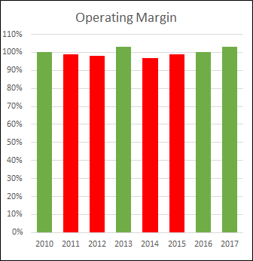
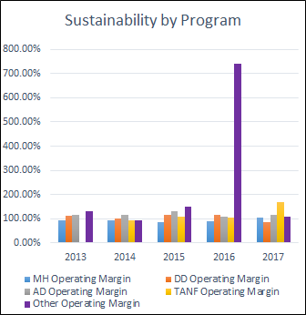
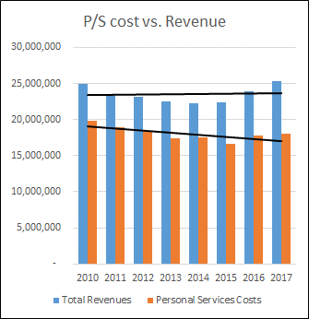
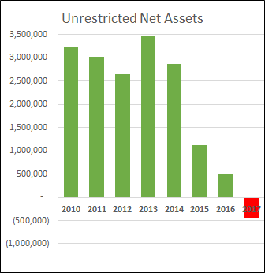
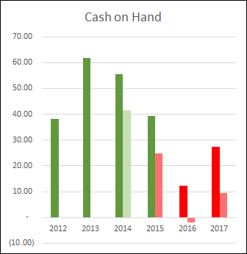
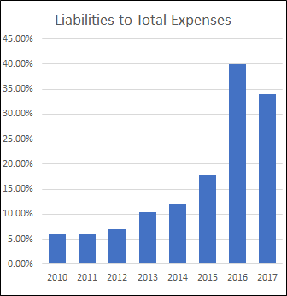
Example

Slide 13
Example
PMR Reporting | 61
Access to Services | 46.7
Crisis | 100
Transitions | 0.0
Care | 100
AD Svcs | 40.0
Admin/Fiscal | 42.5
ASO/Audit | 100
Eligibility | 100
Prevention | 100
Housing Access | 100
BH QEPR 8-2017
90%
DD QEPR 6-2017
89%
OIARM Risk Assessment Score
61

Slide 14
CSB Financial Risk Map

Slide 15
Monitoring the Safety Net
Moderate
Periodic
High
Active
Critical
Intervention
Low

Slide 16
CSB Financial Risk Map

Slide 17
Monitoring the Safety Net
High
Critical
Ongoing monitoring of financial condition, board meetings, service delivery, etc.
Require Sustainability Plan
Provide Technical Assistance
Ongoing monitoring of financial condition, board meetings, service delivery, etc.
Require Sustainability Plan
Provide Technical Assistance
Develop alternative management scenarios

Slide 18
2009 – 2019: A Decade of Transformation Serving Georgia’s Most Vulnerable Citizens
Georgia Department of Behavioral Health & Developmental Disabilities
Judy Fitzgerald
Commissioner

Slide 19











Then: 2009…A New Department is Formed
ACKNOWLEDGEMENT
Inconsistent and fragmented system
Underfunded
Lacked accountability
Poor customer service

Slide 20
Transformation: Telling OUR Story
COMMITMENT
INVESTMENT
ADJUSTMENT
Division of Developmental Disabilities
Division of Behavioral Health
ENGAGEMENT
Enterprise
Hospital
DEVELOPMENT
ENHANCEMENT
IMPROVEMENT

Slide 21
Our Transformation: Enterprise
COMMITMENT
New Vision and Mission
INVESTMENT
Established ASO
Procure and Implement Infrastructure Engine
ADJUSTMENT
Reorganization
Functional Alignment, Centralization, Creation of DAC and PMQI
ENGAGEMENT
Partnerships
Traditional and Non-traditional, Providers, Advocates, Stakeholders, Consultants
DEVELOPMENT
Project Management Approach
ENHANCEMENT
IT Investments and Tools; Analytics and Efficiencies
IMPROVEMENT
Culture Change
New Staff Orientation, Management Academy, Strengths Deployment Inventory, Brand Refresh

Slide 22
Our Transformation: Hospital
COMMITMENT
Closed Front Door for I/DD; Closed Two Hospitals
INVESTMENT
Investment in Facilities
Furniture Refresh, etc.
ADJUSTMENT
Front-line Pay Raise
ENGAGEMENT
System-wide Key Performance Indicators (KPIs)
DEVELOPMENT
Instituted Governing Body for Improved Oversight
ENHANCEMENT
New Treatment Malls at Each Hospital
IMPROVEMENT
Successful Emergency Response through Two Hurricanes

Slide 23
Our Transformation: Intellectual and Developmental Disabilities
COMMITMENT
Re-designed the COMP Waiver Program
INVESTMENT
Rate Adjustments
Rate Study, Rate Increase, Flex Rates to Meet Individual Need
ADJUSTMENT
Re-designed Process of Transition from Hospital to Community
ENGAGEMENT
Established Office of Health and Wellness
Clinical Oversight, High Risk Surveillance, HC Plans, Nursing Standards
DEVELOPMENT
Enhanced Network
Nutrition, HC Partners, Allied Health, Behavior Supports
ENHANCEMENT
Overhauled Support Coordination
Role Change, Implement Intensive Support Coordination
IMPROVEMENT
Re-designed the Planning List

Slide 24
Our Transformation: Behavioral Health
COMMITMENT
Re-designed the Network
Service Standards, Provider Tiers
INVESTMENT
Developed, Measured, and Monitored Key Performance; Improved through Analytics
ADJUSTMENT
Implemented New Community-based Services
ACT, BHCC, Mobile, Respite, Supported Housing, Supported Employment
ENGAGEMENT
Clinical Innovation and Leadership
Symposium, Regional Tours, Beck Institute, Center of Excellence, FEP
DEVELOPMENT
Georgia Housing Voucher (Need and Choice)
Housing Outreach Coordinators
ENHANCEMENT
Enhancement of Georgia’s Peer Network
Forensic, Hospital, Parent, Youth
IMPROVEMENT
Centralized Crisis Dispatch and Access to Crisis Care

Slide 25
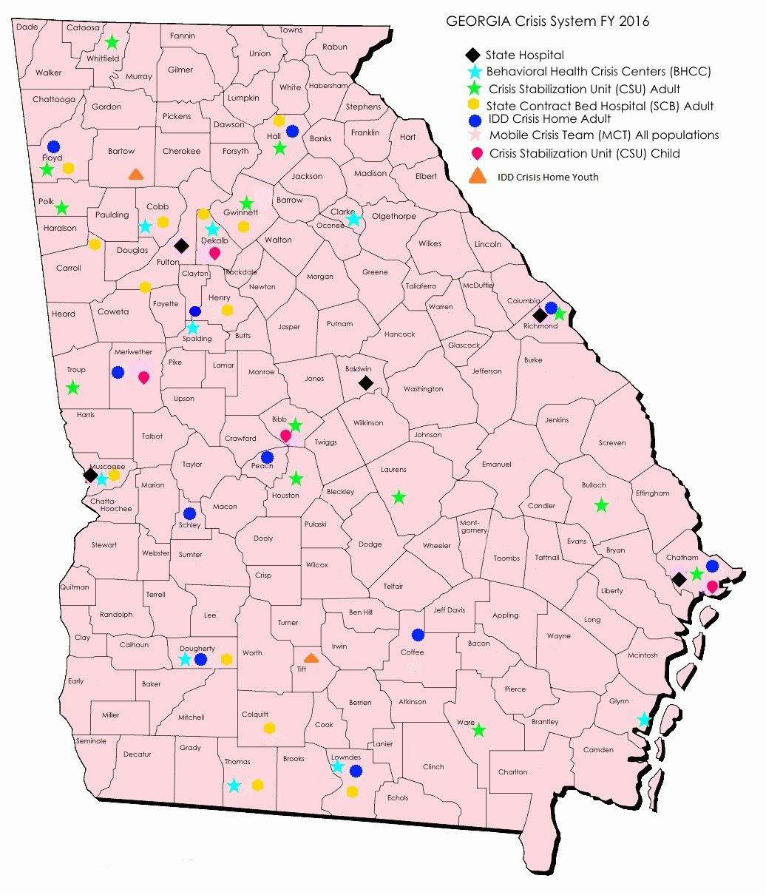
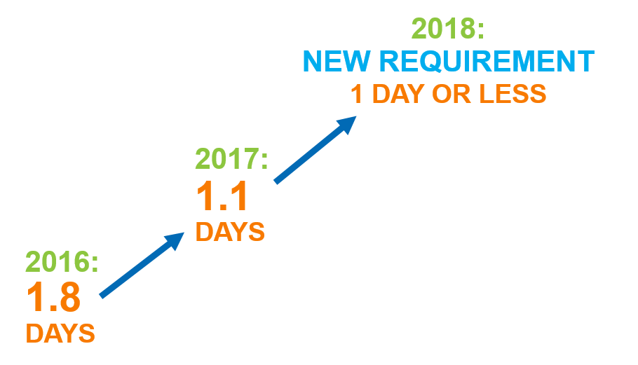
Top 10 Measureable Achievements
10
Right Sizing of Budget and Beds—Crisis Services
9
Implement KPIs
Measure and Improve Access
REDUCTION IN THE LENGTH OF TIME IT TAKES TO SCHEDULE ASSESSMENT APPOINTMENTS

Slide 26
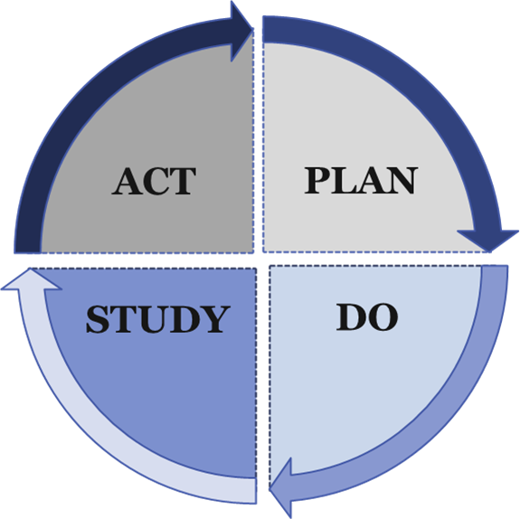
Top 10 Measureable Achievements
8
Mortality Report with Quality Improvement Strategies
7
Investment in Hospital Facilities and Services—Reduction in Hospital Recidivism
Mortality Rate (Deaths per 1,000)
Notes:
Population-based health improvement
Community physician engagement
Surveillance and clinical oversight
ISP revision and quality assurance directives
Intensive support coordination
Behavior supports in the community
System improvement activities target critical variables, such as age and health risk

Slide 27
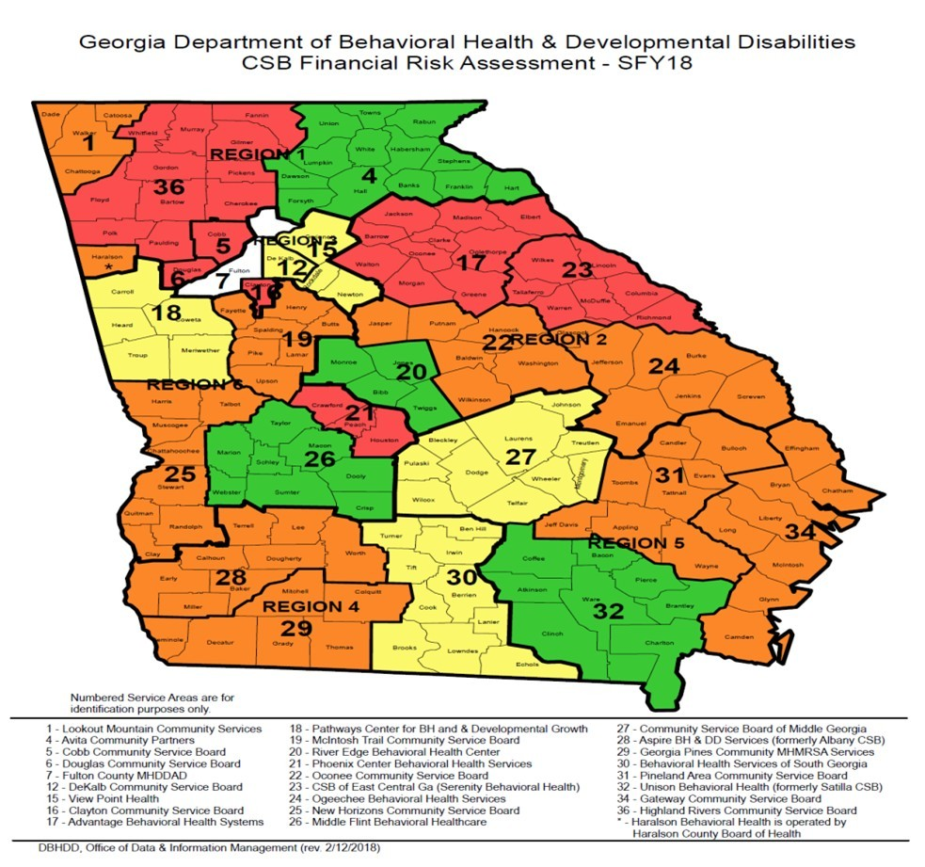
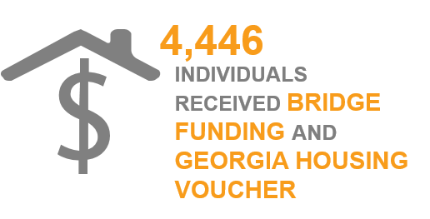
Top 10 Measureable Achievements
6
Creation of Risk Map for Safety Net in FFS/Transparency and Accountability in Safety Net
5
Successful Georgia Housing Voucher Program
2,628
INDIVIDUALS WITH CURRENT SIGNED LEASES

Slide 28
Top 10 Measureable Achievements
4
Mobile Crisis
3
Census Change of Individuals with I/DD in State Hospitals
96%
DD MOBILE CRISIS DISPATCHES
RESOLVED IN HOME/COMMUNITY
NO ESCALATION
IN CRISIS SYSTEM PLACEMENT
61%
OF BH MOBILE CRISIS DISPATCHES

Slide 29

Top 10 Measureable Achievements
2
$256 Million Investment
1
High Performing Agency— Increased Credibility

Slide 30



Advancement: Beyond Compliance — Looking to 2019
Urgent and critical priorities warrant additional focus and development
Outpatient “Core” Funding
Whole Health for BH and I/DD Population
Increasing demand; Growing population; Treating before crisis
Coordinating BH and I/DD services within health care system; Promoting the overall well-being of the individual
Opioid Crisis
Increasing access; Reduce overdose deaths; Prevention, Treatment, and Recovery
Value-Based Purchasing
Preparing the network for alternative payment mechanisms; Rewarding positive outcomes
Crisis Support
Integrating, enhancing, and expanding crisis services; Meeting current and addressing forecasted need
Forensic Population
Ensuring viable facilities and workforce; Addressing growing population of individuals involved with court systems
Children and Youth Services
Implementing Children’s MH Commission report; Developing innovative programming; Collaborating with child-serving partners
Aging Population
Facing clinical and fiscal challenges resulting from aging individuals and caregivers
Prevention
Establishing sustainable prevention programs across the lifespan (Suicide Prevention, SU Prevention, MH Promotion)
National Workforce Shortage
I/DD Transitions: Planning List and Hospitals
Developing short- and long-term strategies; Address impact on Georgia with particular attention to rural areas
Implementing 5-year plan: Addressing current needs and anticipating future demand; Continue hospital transitions

Slide 31
Then: 2009…A New Department is Formed
ACKNOWLEDGEMENT
Inconsistent and fragmented system
Underfunded
Lacked accountability
Poor customer service

Slide 32

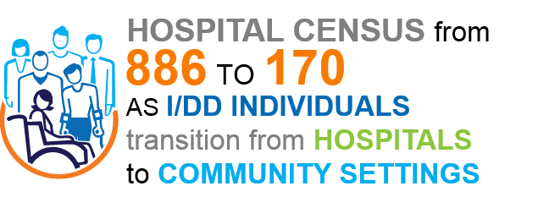
Now: OUR ACHIEVEMENT

Slide 33
Chair’s Report Kim Ryan Chair

Slide 34
Public Comment

Slide 35
Next Board Meeting Thursday, June 14, 2018 1:00 p.m.

