Slide 1
Overview of Mental Health Medications for Children and Adolescents
Module 5
ADHD and Disruptive Behavior Disorders

Slide 2
ADHD: Pharmacotherapy
Stimulants
  Methylphenidate Vyvanse (lisdexamfetamine)
  Amphetamines
  Atomoxetine (Strattera)
Other
  TCAs
  Welbutrin
  SSRIs
  Modenifil

Slide 3
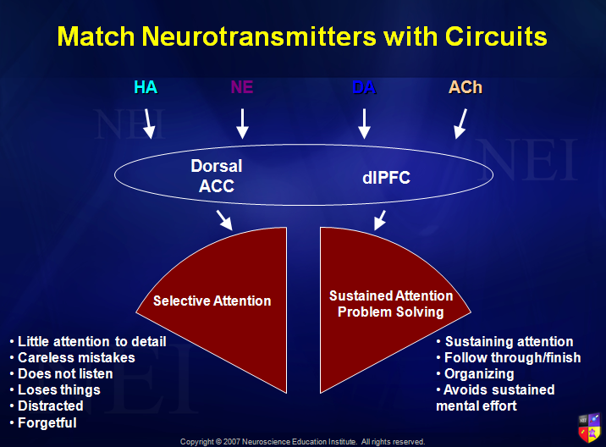

Slide 4
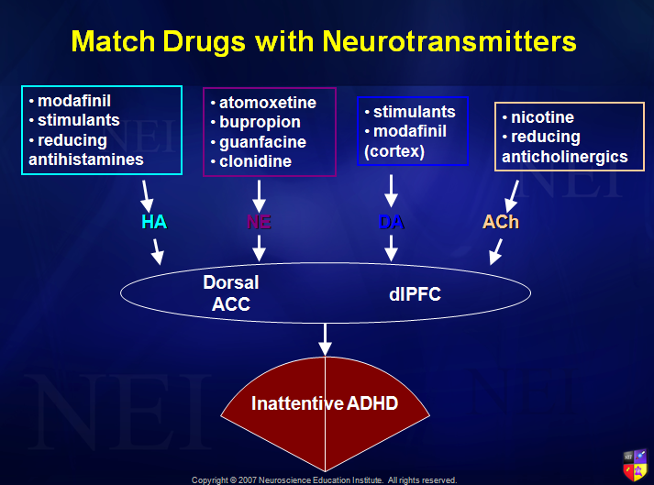

Slide 5
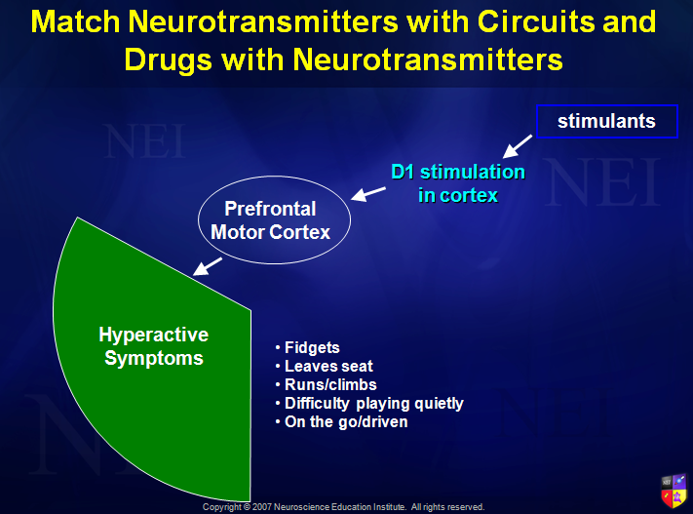

Slide 6
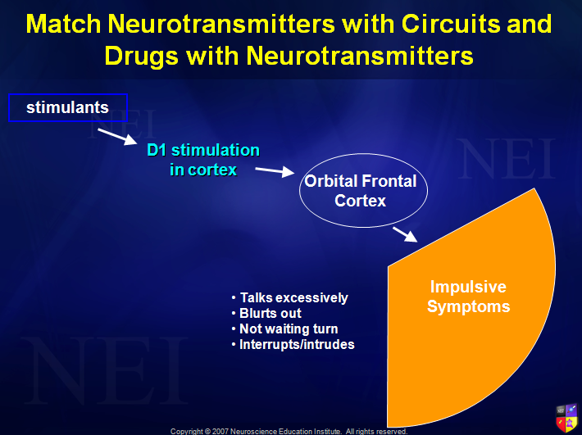

Slide 7
ADHD: Stimulants
Produce behavioral effects by increasing synaptic activity of monoamines (DA/NE)
“Excite inhibitory pathways” = greater control
Act as indirect agonists – increase the ability of the transmitter to act without a direct action on postsynaptic receptors
All enhance executive functioning in the prefrontal cortex which corrects the deficits in inhibitory control and working memory

Slide 8
ADHD: Stimulants
Advantages
  “Safest” of the available medications
  Considered to have a robust short term effect with > 80% benefit
  Wide therapeutic window in dosing schedules and doses
Disadvantages
  Schedule II
  Abuse and diversion

Slide 9
Stimulants: Adverse Effects
Extensions of pharmacology
Common side effects
  Anxiety, irritability, insomnia – dose related
  Anorexia – worse with d-amphetamine and sustained release preparations
  Sympathomimetic effects – BP, HR, headaches

Slide 10
Stimulants: Rx Interactions
Additive effects with other stimulants with increased occurrence of:
  Insomnia
  Sympathomimetic effects
  CNS –irritability, nervousness, seizure
Interaction with dietary supplements and herbs possible

Slide 11
Choosing the right Medication
Most patients will benefit from stimulants that have been approved by the FDA
Most will respond to either methylphenidate or amphetamine but some will respond better to one than the other
No single drug preparation meets the needs of all

Slide 12
Choosing the Right Medication
Not all patients need to be treated for 12 or more hrs each day
Medication after school may not be required if child can get homework done in quiet environment
Afterschool programs may require tweaking of extended release drugs

Slide 13
Choosing the Right Medication
Titration may be difficult
  No relationship between age or body weight and dose
  Marked individual variability in dose response relationship
Specific dose may improve symptoms but higher dose may be needed to improve function
Optimal dose improves symptoms and functionality with minimal adverse effects

Slide 14
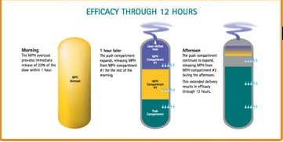
Concerta
Extended release methylphenidate
Tablet uses osmotic technology
Duration 12 hrs
Peak plasma levels 6-8 hrs

Slide 15
Oppositional Defiant Disorder
Negative, hostile or defiant behavior
Symptoms emerge before 8 yrs of age
Can emerge to conduct disorder
  Repetitive, persistent pattern of conduct that violates rights of others
  Aggression, property destruction, lying, theft
  Poor interpersonal skills
  Peer rejection

Slide 16
Mental Health Medications for
Conduct Disorders
Aggression – stimulants
Rage, temper outbursts – anti-convulsants
Aggression – lithium
Over-arousal – clonidine
Severe conduct disorder – atypical antipsychotics, neuroleptics

