Slide 1
COMP Waiver Renewal: Implementation of Program Changes
Catherine ivy
Division of developmental disabilities
Georgia department of behavioral health and developmental disabilities
2017

Slide 2
Significant Changes to the COMP Waiver
Establishes 11 different residential rates, based on
Setting (group home or host home),
Size of the home, and
Support needs of the individual
Adds nutrition services to the list of services available through the waiver (maximum: $1,800)

Slide 3
Significant Changes to the COMP Waiver
Increases the cap on physical, occupational, and speech therapies from a total therapy cap of $1,800 to $5,400 annually
Moves community living support from a two-rate to a six-rate model
Restructures respite rates to accommodate one waiver participant, or two-to-three waiver participants served concurrently

Slide 4
Significant Changes to the COMP Waiver
Expands overnight/daily respite to two levels following the host home levels
Adds a new service, additional residential staffing,
Removes enhanced staffing from an exceptional rate model

Slide 5
Residential Services
Significant changes:
Creates rate categories

Slide 6
Begins with Level of Assessed Need
Determined using specific information discovered through administration of the HRST and the SIS
Examples:
If an individual is classified by the HRST as Health Care Levels (HCL) 3 or 4 (moderate risk), he/she will be eligible for assessment level 3
If an individual is classified as HCL 5 or 6 (high risk), he/she will be eligible for assessment level 6

Slide 7
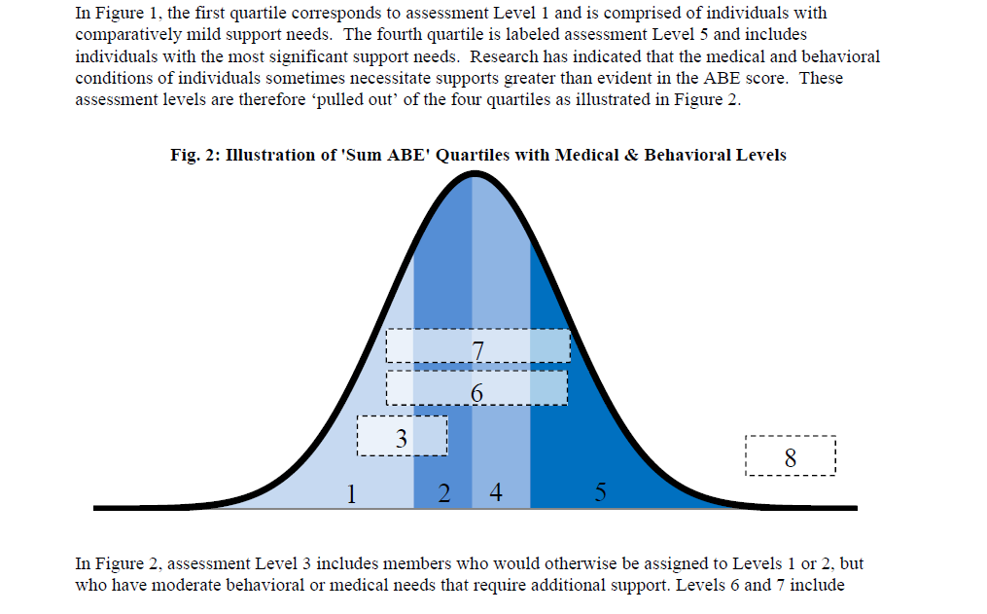
Begins with Level of Assessed Need
http://dbhdd.georgia.gov/residential-and-respite-cost-study

Slide 8
Certain Assessment Levels Require Review
Verification: reviews additional information provided by SIS supplemental questions about behavioral needs
Purpose: to determine most appropriate rate tier based on additional information collected through the SIS supplemental questions
Confirmation: reviews HRST changes from baseline that change the individual assessment level
Purpose: to review clinical information affecting individual need

Slide 9
Further Calculates Using Type of Setting and Size
Residential Capacity | Category | Unit of Service | Rate
4-Person | Category 1 (Level 1) | 1 Day | $154.74*
4-Person | Category 2 (Level 2) | 1 Day | $214.80
4-Person | Category 3 (Level 3, 4) | 1 Day | $239.73
4-Person | Category 4 (Level 5, 6, 7) | 1 Day | $254.36
3-Person | Category 1 (Level 1) | 1 Day | $178.53
3-Person | Category 2 (Level 2) | 1 Day | $235.05
3-Person | Category 3 (Level 3, 4) |  | $261.48
3-Person | Category 4 (Level 5, 6, 7) |  | $277.44
1-2 Person | Category 1 (Level 1, 2, 3, 4) |  | $149.45 *
1-2 Person | Category 2 (Level 5, 6, 7) |  | $185.25
*These two rates annualize to the current rate, $158.56, representing no reduction in reimbursement rate
**Home capacity refers to the HFR license capacity

Slide 10
Staff Expectations Consistent with Rate Categories
Levels – 4-person residence | Allocated Staff Hours Per Week
Category 1 | 45.3 per person
Category 2 | 55.3 per person
Category 3 | 66.5 per person
Category 4 | 80.5 per person
Levels – 3-person residence | Allocated Staff Hours Per Week
Category 1 | 53.7 per person
Category 2 | 60.3 per person
Category 3 | 73.7 per person
Category 4 | 88.7 per person

Slide 11
Specifics of Residential Reimbursement
Changes the current billing limit of 27 days per month/324 days/year to 344 days per year
Providers can submit claims for all days of the month when the individual is present overnight but will expend all units with 21 days remaining in the plan year
Requires that host home provider agencies pass through at least 60 percent of the payment that they receive to the home provider

Slide 12
Reimbursement Timelines and Exceptional Rates
All community residential alternative services will be assigned a rate category through prior authorization retroactive to March 1, 2017, except for individuals approved for an exceptional rate.
ER Renewal Requests for those expiring before March 31 will be honored and processed
New ER Requests beginning March 1 will be processed per the new method
Webinar training scheduled for 3/17 and 3/24 for providers with current exceptional rates
Current ERs less than the new assessed rate:
Will be moved to the new rate retroactively to begin March 1, 2017
Current ERs greater than the new assessed rate:
Will be maintained at the current rate until the waiver participant’s reevaluation and development of the new annual individual service plan (ISP).
The beginning of the new Plan Year will move reimbursement to the new rate model

Slide 13
Community Living Support Services
Significant changes:
Shared CLS
Basic CLs
Extended cls

Slide 14
Changes to CLS
Service | Unit | Rate | Notes
Basic | 15-minute | $6.35 | Basic service = 11 or fewer units/visit
Extended | 15-minute | $5.74 | Extended service = 12 or more units/visit
2 Members - Basic | 15-minute | $3.49 | Allows waiver participants to share one DSP Designed for voluntary staff sharing to allow purchase of more hours Clinical need, different needs, or significant difference in assessment levels may require continuation of individual model, even if participants live in the same home
2 Members - Extended | 15-minute | $3.16
3 Members - Basic | 15-minute | $2.54
3 Members - Extended | 15-minute | $2.30

Slide 15
Other CLS Changes
Daily CLS rate will be converted to equivalent 15-minute units
CLS Cap: $51,300
No daily maximum; no monthly maximum
Providers and families must manage carefully to avoid exhausting available funds prematurely
The division will analyze claims data to assist management through support coordination
New procedure code for personal assistance retainer

Slide 16
Additional Residential Staffing
New service

Slide 17
Replaces Enhanced Staffing in CRA and CLS Provided through Exceptional Rate
Eligibility:
Waiver participant exhibits current high level needs as evidenced by:
HRST healthcare level 5 or 6 indicating high medical and/or functional needs verified by DBHDD staff
Exceptional behavioral needs identified by SIS assessment
A DBHDD-performed evaluation or assessment indicating need for enhanced staffing, or
Waiver participant has an active court order which requires specific staffing requirements beyond the scope of traditional CLS or CRA services, or
Waiver participant has transitioned from an ICF-ID or other institution within the past six months and transition needs may necessitate additional residential staffing
Waiver participant has documented history of significant behavior challenges which present risk to him/herself or others in the residential setting

Slide 18
More about Additional Residential Staffing
Requires field office clinical assessment and central office review
Must be supported through description of need in the nursing and/or behavioral assessment and ISP
Complete process description available in Medicaid manual Appendix H on April 1
Service | Unit | Rate
Additional Residential Staffing, Basic | 15-min. | $4.67
Additional Residential Staffing, Enhanced | 15-min. | $5.01

Slide 19
Staff Expectations Consistent with Rate Categories
Provider submits request on behalf of one individual in the home
Requires that allocated staff hours for all individuals served in the home are provided as a baseline for additional staffing request
Levels – 4-person residence | Allocated Staff Hours Per Week
Category 1 | 45.3 per person
Category 2 | 55.3 per person
Category 3 | 66.5 per person
Category 4 | 80.5 per person
Levels – 3-person residence | Allocated Staff Hours Per Week
Category 1 | 53.7 per person
Category 2 | 60.3 per person
Category 3 | 73.7 per person
Category 4 | 88.7 per person

Slide 20
Respite Services
Significant Changes:
Multiple in-home respite options
Two levels of overnight/daily respite

Slide 21
Respite Changes
Service | Unit | Rate | Notes
Respite-15-Minutes 1 Member | 15-min | $4.83 | Allows sharing of in-home respite for maximum hours Can be used for siblings living together or by individuals living with family who are compatible and choose to share services
Respite-15-Minutes 2 Member | 15-min | $2.66
Respite-15-Minutes 3 Member | 15-min | $1.93
Respite-Daily Category 1 | One day | $153.61 | Follows same assessment level as Category 1 host home
Respite-Daily Category 2 | One day | $209.51 | Follows same assessment level as Category 2 host home

Slide 22
Other Respite Information
Annual Limit Day Service: 30 units
Annual limit is as authorized in the individual budget up to the annual maximum of
$6,285 for Category 2 Respite
$4,608 for Category 1 Respite
Annual limit can be used for in-home respite, daily/overnight respite, or combination

Slide 23
Information about Prior Authorization and Claims Reimbursement
Prior authorization updates for residential services will be accomplished electronically, allowing providers to bill claims for services rendered on or after March 1, 2017
Prior authorization on behalf of most individuals receiving residential services will be available by March 15, 2017
Prior authorization updates for other services, such as respite and CLS, may be delayed until as late as March 31, 2017, but all rate changes will be retroactively effective as of March 1, 2017
DCH will post banner messages related to specific instructions about claims submissions and adjustments
Banner message will advise providers to adjust claims versus voiding and resubmitting

Slide 24
Other
Change in Specialized Medical Supplies
Cost cap increase to $3,800 annually
Additional Units request for Specialized Medical Supplies
Processing requests as usual. No changes
Enhanced support requests for Community Access Group
Processing requests as usual
Phase 2 of the Rate Study to focus on Community Access Services

Slide 25
Questions?
You can continue to submit questions about new policy or waiver implementation to: COMPImplementationQuestions@dbhdd.ga.gov
Questions will be categorized and compiled; then posted as FAQs on the DBHDD website

