Slide 1
Board of Behavioral Health and Developmental Disabilities
Georgia Department of Behavioral Health & Developmental Disabilities
December 14, 2017

Slide 2
Agenda
Call to Order
Recovery Speaker
Action Items Approval of Minutes Board Resolution
Commissioner’s Report
Commissioner’s Report
Chair’s Report
Public Comment
Next Meeting Date

Slide 3
Call to Order Kim Ryan Chair

Slide 4
Recovery Speaker Arlene Oliver RESPECT Institute of Georgia

Slide 5
Action Items - Approval of Minutes - Board Resolution

Slide 6
Commissioner’s Report Judy Fitzgerald Commissioner

Slide 7
Commissioner’s Report
1
DBHDD Brand Refresh
Medication-Assisted Treatment Audit Report
Belton Update
Children’s Mental Health
Recommendations of the Multi-Agency State Autism Collaborative
Mental Health Settlement Extension Targets: Supported Housing
2
3
4
5
6

Slide 8
DBHDD Brand Refresh

Slide 10
Medication-Assisted Treatment Audit Report Judy Fitzgerald Commissioner

Slide 11
Belton Update Amy Howell Assistant Commissioner and General Counsel

Slide 12
Federal Statutes
Title II of the Americans with Disabilities Act of 1990:
"No qualified individual with a disability shall, by reason of such disability, be excluded from the participation in or be denied the benefits of the services, programs or activities of any public entity, or be subject to discrimination by any such entity." 42 U.S.C. § 12132.
Section 504 of the Rehabilitation Act of 1973:
"No otherwise qualified individual with a disability in the United States . . . shall, solely by reason of her or his disability, be excluded from the participation in, be denied the benefits of, or be subjected to discrimination under any program or activity receiving Federal financial assistance . . ." 29 U.S.C. § 794.
Notes:
Provisions Requiring Compliance with Federal Statutes
DCH Part I Manual:
“As general conditions of participation, all enrolled providers must provide services in compliance with Section 504 of the Rehabilitation Act of 1973 and the Americans with Disabilities Act of 1990.”
DCH Policies and Procedures for Medicaid/Peachcare for Kids, Part I, Chapter 100, “Information,” 106(d) (p. 41).
DBHDD Contract with CSBs, Paragraph #107(C):
“The Contractor agrees to comply with all applicable provisions of the Americans with Disabilities Act (ADA) and any relevant federal and state laws, rules and regulations regarding employment practices toward individuals with disabilities and the availability/accessibility of programs, activities, or services for consumer/customers/clients with disabilities.”

Slide 13
The Belton Order
Arose from a class action alleging deficiencies in Georgia’s provision of behavioral health and developmental disabilities services to individuals with hearing loss
Consent order issued in October 2014
For MH services, provisions of the order apply only to individuals receiving outpatient non-crisis group, family, and individual therapy services
For DD services, provisions of the order apply only to COMP-funded individuals

Slide 14
Belton Order Definitions
Deaf individual – Any individual whose hearing is totally impaired or whose hearing is so seriously impaired as to prohibit the individual from understanding oral communications spoken in a normal conversational tone. This can be a self-identified classification regardless of the severity of the hearing loss or mode of manual communication preferred.
Qualified Interpreter – An interpreter who has:
1. A current national certification as a sign language interpreter as awarded or honored by the Registry of Interpreters for the Deaf, Inc.;
2. Attended at least forty (40) hours of mental health interpreter training administered by a state-operated agency or a nationally recognized mental health interpreter training program; and
3. Verification of participating in at least forty (40) hours of a practicum as approved by DBHDD's Deaf Services office.

Slide 15
MH services for deaf individuals
Communication Assessments are provided for individuals who may be “deaf individuals” as defined by the order in connection with their entering non-crisis services
Qualified Interpreters are available in CSB services
“Designated Providers” (DPs) are available to provide services for “deaf individuals” in non-crisis outpatient MH therapy services.
ASL-fluent therapists or counselors provide non-crisis related outpatient therapy or counseling services and/or case management services to D/MI Class Members. Services may be provided through telemedicine if in accordance with the individual’s preference.
Notes:
“Designated Providers” (DPs) are available to provide services for “deaf individuals” in non-crisis outpatient MH therapy services.- through telemedicine with plans to hire additional therapists in the coming year.

Slide 16
IDD services for deaf individuals
Communication assessments are completed for Deaf Class Members already awarded funding for COMP services.
The communication assessment results include (but are not limited to):
Determination of any communication limitations;
Associated reasonable accommodations; and
Recommendations for type of appropriate and accessible group and host home staffing requirements
Physical accommodations are implemented.
Staff are trained to facilitate better communication with individuals.

Slide 17
Deaf Services
Office of Deaf Services established and staffed
ASL training for providers and their staff
Mandatory provider trainings on how to provide access and effectively support deaf individuals
Outreach to deaf community to share information regarding available services
Notes:
The Belton Settlement Training is MANDATORY for any Provider currently supporting/serving individuals with a hearing disability. This informational training will focus on how to effectively support waiver participants who are deaf, hearing-impaired or hard-of-hearing in meeting their expressive and receptive communication needs and achieving more successful community integration.

Slide 18
Children’s Mental Health Danté McKay Director Office of Children, Young Adults, and Families

Slide 19
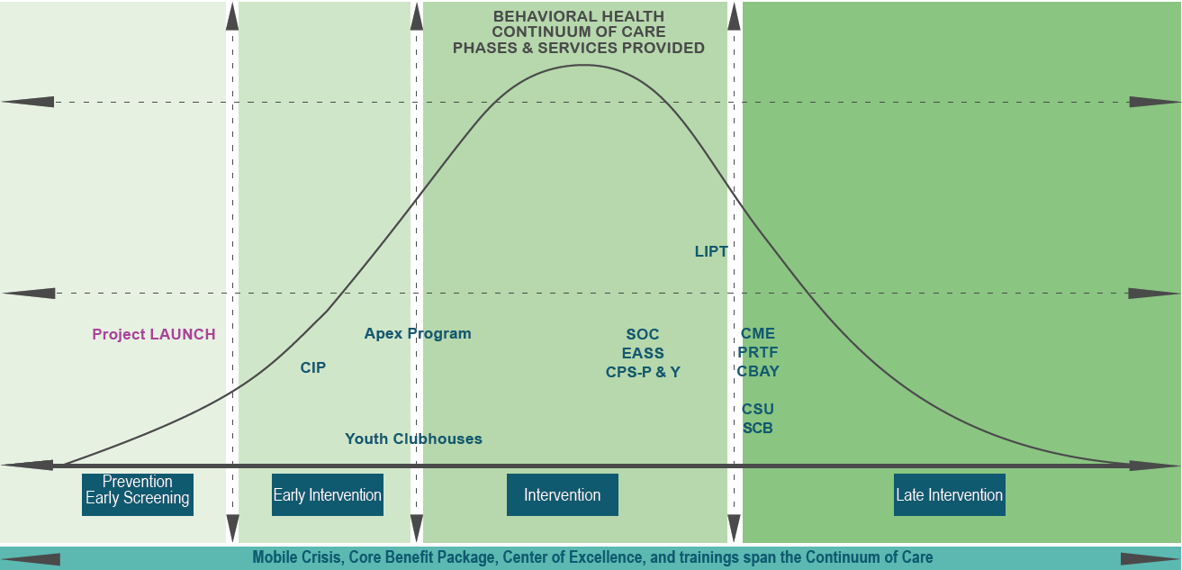
Public System Service Array for Children, Young Adults, and Families
Services Supported by DBHDD and DCH

Slide 20
Service Array
Prevention/Early Intervention
Project LAUNCH
Early Intervention
Community Innovation Program
Early Intervention/Intervention
Georgia Apex Program
Mental Health Clubhouses

Slide 21
Service Array
Intervention
Emerging Adult Support Services
Local Interagency Planning Teams (LIPT)
System of Care
Late Intervention
Crisis Stabilization
High Fidelity Wraparound
Certified Peer Support-Parent and -Youth
Psychiatric Residential Treatment Facilities

Slide 22
Service Array
Spans Continuum of Care
Core Benefit Package
Mobile Crisis
Trainings
Center of Excellence for Children’s Behavioral Health

Slide 23
Thank You!
Danté T. McKay, JD, MPA
Director, Office of Children, Young Adults, and Families
Behavioral Health Division
Department of Behavioral Health and Developmental Disabilities
dante.mckay@dbhdd.ga.gov

Slide 24
Recommendations of the Multi-Agency State Autism Collaborative Wendy Tiegreen Director Office of Medicaid Services

Slide 25
Autism Spectrum Disorder (ASD)
1:64 children (ages 0 to 21) in Georgia have Autism Spectrum Disorder (ASD)
1.1 million children younger than 21 years of age in Georgia on Medicaid
Estimated 17,000 children with autism enrolled in Georgia Medicaid
Spring 2017: Governor Deal’s Budget Proposal/Legislative Approval
Initiated Tri-Department Planning Initiative
Department of Behavioral Health & Developmental Disabilities
Department of Community Health
Department of Public Health
Partner Informants include Department of Human Services and Department of Education

Slide 26
Current State of Medicaid Autism Services
Developmental
Screening*
Referral for Diagnosis
Non-Behavioral Therapies
Ages 0 to 3
Ages +/- 5
Ages 0 to 21
Recommendations of the multi-agency state autism collaborative

Slide 27
Toward a Full Range of Services
Intensive
ASD Behavior Therapies
⇦ Ages 0 through 20 ⇨
Respite
Intensive
Crisis Support
ASD-Specific Screening
Comprehensive Assessment
ASD Skills Building
Diagnosis
Crisis Stabilization Capacity
Intensive
ASD
Group/Family Skills and
Supports
Mobile Crisis
Recommendations of the multi-agency state autism collaborative
Notes:
Changed title to help guide expectations that this system won’t change overnight
Also added reminder that access to non-behavioral services will continue
Changed ‘autism’ to ASD to keep language consistent

Slide 28
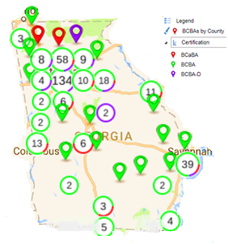
ABS Providers
Capacity limitations based on already employed workforce
Behavioral analysts
BCBA-D: doctoral level
BCBA: master’s/graduate level
BCaBA: bachelor’s level; requires supervision
Certification | Statewide Count
BCBA-D | 49
BCBA | 284
BCaBA | 26
Grand Total | 359
Additional 323 Registered Behavior Technicians
Recommendations of the multi-agency state autism collaborative

Slide 29
Proposals for Capacity Building
Use telemedicine
Equipment
Training
Infrastructure investment
Engaging community service boards and public health sites as partners
Administrative oversight and implementation of key workforce and infrastructure activities
Options for southern/southwest network development
Education opportunities
Expand to include crisis services
Crisis stabilization
Crisis respite
Mobile crisis
Intensive support coordination
Recommendations of the multi-agency state autism collaborative

Slide 30
Mental Health Settlement Extension Targets: Supported Housing Terri Timberlake, Ph.D. Director Office of Adult Mental Health

Slide 31
Provisions Related to People with Serious and Persistent Mental Illness (“SPMI”)

Slide 32
Target Population
30. For purposes of Paragraphs 31 to 40, the "Target Population'' includes the approximately 9,000 individuals with SPMI who are currently being served in State Hospitals, who are frequently readmitted to the State Hospitals, who are frequently seen in emergency rooms, who are chronically homeless, and/or who are being released from jails or prisons. The Target Population also includes individuals with SPMI and forensic status in the care of DBHDD in the State Hospitals, if the relevant court finds that community services are appropriate, and individuals with SPMI and a co-occurring condition, such as substance abuse disorders or traumatic brain injuries.

Slide 33
Demonstration of Compliance: Bridge Funding
TARGET | STATUS
By June 30, 2016, an additional 300 individuals served via bridge funding (for a total of 2,100) | 3,248 people have received bridge funding
By June 30, 2017, an additional 300 individuals served via bridge funding (for a total of 2,400) | 4,655 people have received bridge funding

Slide 34
Demonstration of Compliance GHVP
TARGET | STATUS
34. By June 30, 2016 an additional 358 individuals served via housing voucher (requirement from the end of original Settlement Agreement 2,000 + 358 = 2358) | 3,020 people have been served via the GHV
35. By June 30, 2017, an additional 275 individuals will receive the GHV (for a total of 2,633) | 4,368 people have been served via the GHV

Slide 35
Supported Housing
37. Supported Housing includes scattered-site housing as well as apartments clustered in a single building. Under this Extension Agreement, the State shall continue to provide at least 50% of Supported Housing units in scattered-site housing, which requires that no more than 20% of the units in one building, or no more than two units in one building (whichever is greater), may be used to provide Supported Housing.

Slide 36
Demonstration of Compliance
37. Supported housing includes scattered-site housing as well as apartments clustered in a single building. As of June 15, 2017
 | In Housing | Scattered Site | Congregate | % Scattered Site
Region 1 | 280 | 247 | 32 | 88%
Region 2 | 321 | 296 | 10 | 92%
Region 3 | 748 | 640 | 108 | 86%
Region 4 | 351 | 281 | 70 | 80%
Region 5 | 429 | 412 | 17 | 96%
Region 6 | 194 | 152 | 42 | 78%
Total | 2,323 | 2,029 | 294 | 87%

Slide 37
Supported Housing
38. Under this Extension Agreement, by June 30, 2018, the State will have capacity to provide Supported Housing to any of the individuals in the Target Population who have an assessed need for such support.

Slide 38
Demonstration of Compliance
38. and 39. B.
Determination of Need for Supported Housing: Housing Need and Choice Survey
Phase I total completed surveys = 2,706 | 24% (649) needed supported housing at time of survey
Phase II total completed surveys = 1,410 | 53% (746) needed supported housing at time of survey
Notes:
As of 11/30/17

Slide 39
38 and 40. Additional Demonstration of Compliance
Prior living environment of the 2,608 individuals currently receiving the GHV, evidence that all categories of the Settlement target population are accessing supported housing
Category | Number | Percent
Homeless | 1,521 | 58%
Other Residential (pch, crr, shelter) | 333 | 13%
Hospital/CSU/ BHCC | 244 | 9%
Jail/Prison | 124 | 5%
Other/ friends/family | 386 | 15%

Slide 40
Supported Housing Resources Coordination
Maximization of the Georgia Housing Voucher Program;
Effective utilization and coordination of available state housing resources
(f) Coordination of available state resources and state agencies.

Slide 41
39. Demonstration of Compliance
DBHDD will demonstrate compliance through the provision of a process flow chart for a unified referral strategy
Monthly interagency work group established; representation from DCA, DBHDD, DCS, VA, Atlanta CoC, MFP, GDC- Coordinated Re-Entry staff.
DBHDD providers now have the ability to make direct referrals to DCA within the Need for Supported Housing Survey application once an individual has been identified who a) meets settlement criteria, and b) has a demonstrated need for supported housing.
Notes:
September; completion of IT system reconfiguration

Slide 42
39. A. DBHDD/DCA Unified Referral Process
DCA Supported Housing Unified Referrals include the following:
Tenant Based Housing Choice Voucher (HCV)
HUD 811
VASH
HOPWA
Homeless Continuum of Care Programs
Notes:
September

Slide 43
39. C. and E. Supported Housing
Statewide implementation of process for increasing transition from GHV to HUD 811
Statewide implementation of process for increasing conversion of GHVP to HCV
Multi-agency Unified Referral process implementation
Collaboration with Department of Community Supervision specific to returning citizens/re-entry and Unified Referral process; facilitating coordinated entry
Coordination with Atlanta CoC for Unified Referral, and MCRS linkage
Notes:
Turnover approx. 25 /month
PHA agreement – current w.Atl., Macon in process

Slide 44
Supported Housing
Coordination of state housing resources, maximization of GHV and supported housing capacity
Housing Capacity | FY 2018
GHVP | 960
HUD 811 | 330
Public Housing Authority Partnerships (HCV) | 400
Total | 1,690
Notes:
Turnover approx. 25 /month, Atlanta and Columbus housing authority

Slide 45
Supported Housing Resources Coordination
Maximization of the Georgia Housing Voucher Program
Effective utilization and coordination of available state housing resources
Increasing transition from GHV to HUD 811 and conversion of GHVP to HCV
Multi-agency Unified Referral process; DBHDD providers now make referrals to DCA, once an individual has been identified who a) meets settlement criteria, and b) has a demonstrated need for supported housing.
Notes:
Turnover approx. 25 /month
PHA agreement – current w.Atl., Macon in process

Slide 46
Supported Housing Resources Coordination
DCA Supported Housing Unified Referrals include the following rental programs:
Tenant Based Housing Choice Voucher (HCV)
HUD 811
VASH
HOPWA
Collaboration with Department of Community Supervision specific to returning citizens/re-entry and Unified Referral process; facilitating coordinated entry
Coordination with Atlanta CoC for Homeless Continuum of Care Programs
Notes:
Turnover approx. 25 /month
PHA agreement – current w.Atl., Macon in process

Slide 47
Demonstration of Compliance Supported Housing Outreach
Outreach efforts to target population in jail/prison, and who are homeless
Facilitation of Housing Need and Choice Surveys in select jails and prisons
Provision of Supported Housing Need and Choice Survey informational pamphlet to all jails
Facilitation of NSH by all 10 PATH teams
Housing Outreach Coordinators: 11 new statewide positions

Slide 48
Chair’s Report Kim Ryan Chair

Slide 49
Public Comment

Slide 50
Next Board Meeting Thursday, February 15, 2018 1:00 p.m.

Slide 51
Georgia Department of Behavioral Health & Developmental Disabilities
Notes:
USE AS END SLIDE if needed

